Slide 1
Mapping the impact of temperature and salinity on EOR polyacrylamide performance in reservoir and in produced water treatment
Leena Nurmi, Luciana Bava, Mehrdad Hesampour, Sirkku Hanski
luciana.bava@kemira.com
erica.pin@kemira.com

Slide 2
Table of content
Introduction
Objectives
Materials
Results – Contour maps
Conclusions

Slide 3
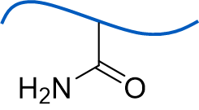
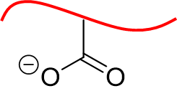
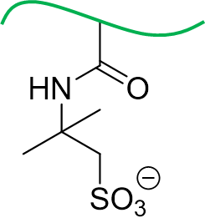
Introduction
Acrylamide
Anionic polyacrylamides are widely used in polymer flooding
Selection of optimal chemical composition of polyacrylamide based on:
  Reservoir and water treatment conditions both considered
  Temperature, salinity, hardness
  Copolymers of acrylic acid and acrylamide (HPAM) for moderate conditions
    Temperature below 50-60°C or low salinity or low hardness
  ATBS (sulfonation) can be added for harsher conditions
Acrylic acid
ATBS

Slide 4
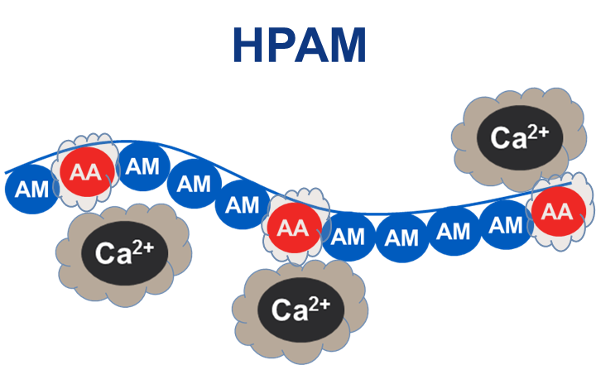
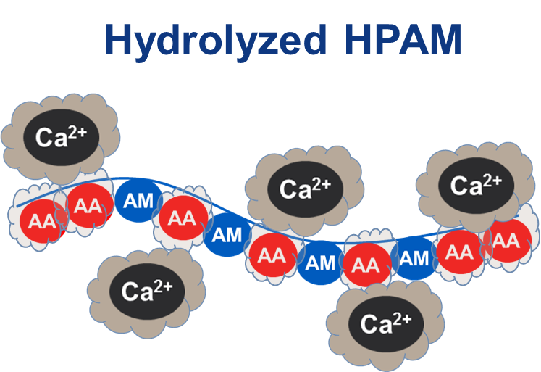
Introduction
Acrylic acid (AA) → multivalent cations in brine detrimental for viscosity yield
Hydrolysis reaction takes place above 50-60°C
  Acrylamide (AM) and ATBS → Acrylic acid (AA)
  Rate of hydrolysis highly dependent on reservoir temperature, quite independent on brine composition
Cloud point: AA tolerates multivalent cations better at low temperature → solubility is lost (precipitation) at high temperature
  Cloud point dependent on polymer and brine composition
  Precipitation can occur
ATBS helps
  Slower hydrolysis rate
  Less interaction with multivalent cations

Slide 5
Key messages
Data collected for optimal polyacrylamide selection
Systematic results provided to predict performance over a range of products and conditions (TDS 700 - 170 000 ppm, T up to 90°C):
Initial viscosity yield
  Important at low or moderate reservoir temperature (up to 50-60°C) where stable viscosity expected
Cloud point
  Exceeding polymer cloud point can bring challenges​ at produced water treatment
  Precipitation on hot heat exchanger surfaces → deposits
  Deposit challenges can be mitigated with polyacrylamide sample selection
Thermal stability
  Important at high reservoir temperature (above 50-60°C) where hydrolysis rate significant

Slide 6
Polymer samples
Acrylamide
High molecular weight, typical EOR grades
Polymer | Acrylamide mol% | Acrylic acid mol% | ATBS mol% | Viscosity [cP] 1 mol/kg NaCl 1000 ppm, 25°C, 7.34 1/s
HPAM-20 | 70 | 20 | 0 | 10.8
HPAM-25 | 75 | 25 | 0 | 12.1 (MW > 15 MDa)
HPAM-33 | 67 | 33 | 0 | 11.0
TER-20-5 | 75 | 20 | 5 | 10.5
TER-20-10 | 70 | 20 | 10 | 10.1
ATBS-15 | 85 | 0 | 15 | 10.6
ATBS-25 | 75 | 0 | 25 | 9.4
Acrylic acid
ATBS

Slide 7
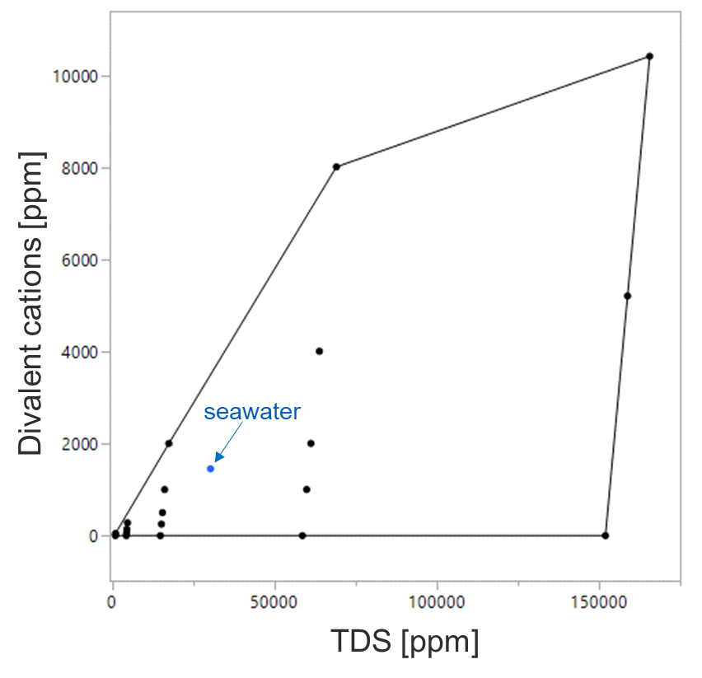
Salinity maps
21 artifical brines
Na⁺, Ca²⁺, Cl⁻ ions
TDS 730 – 170 000 ppm
Ca²⁺ ions 0 – 10 400 ppm

Slide 8
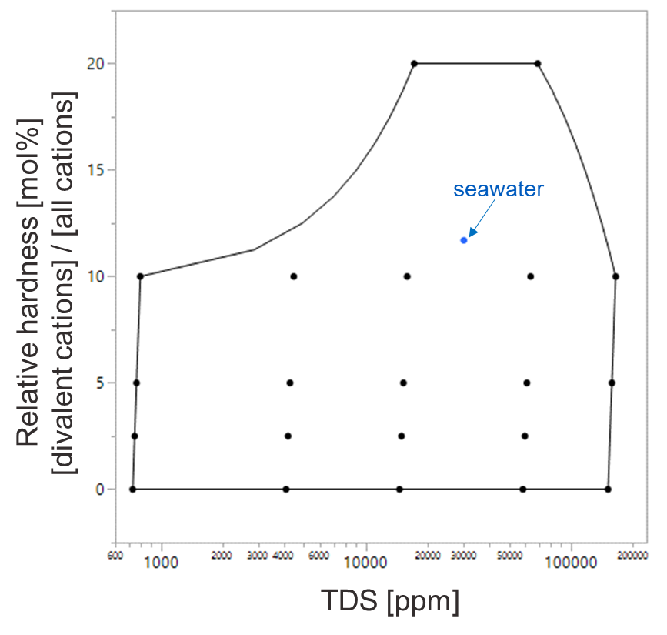
Salinity maps
21 artifical brines
Na⁺, Ca²⁺, Cl⁻ ions
TDS 730 – 170 000 ppm
Ca²⁺ ions 0 – 10 400 ppm
Relative hardness 0 – 20 mol%
Multivalent cations [mol] (Ca²⁺, Mg²⁺,…)
Relative hardness [mol%] =
All cations [mol]

Slide 9
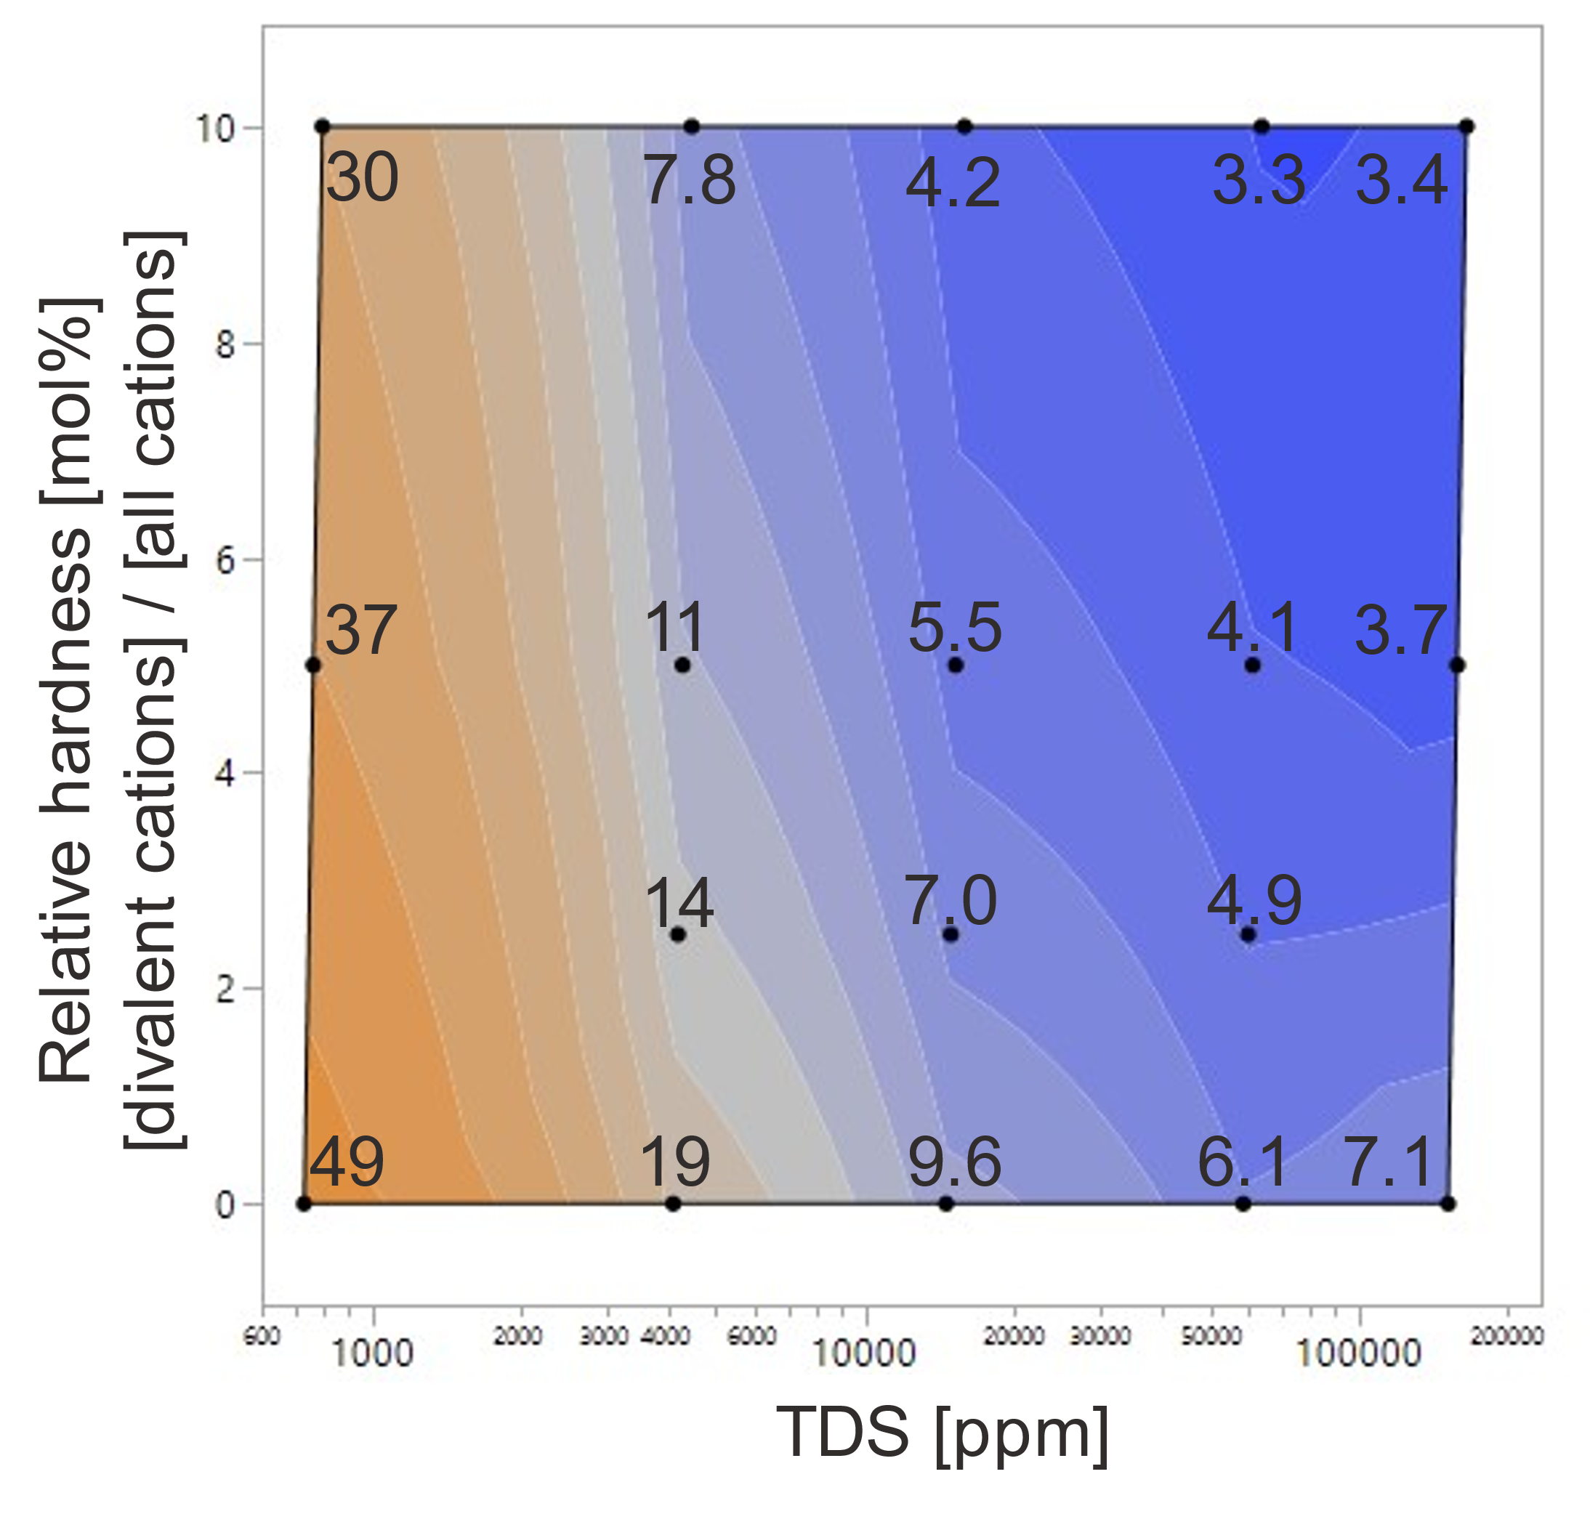
Viscosity yield
HPAM-33, 60°C, 7.34 1/s
Viscosity yield measured at 1000 ppm polymer concentration
  25°C, 60°C, 90°C
Results shown in the salinity map
Similar maps available for other samples (HPAM, terpolymers, ATBS-copolymers)
  Nurmi et al. 2023, EAGE IOR+

Slide 10
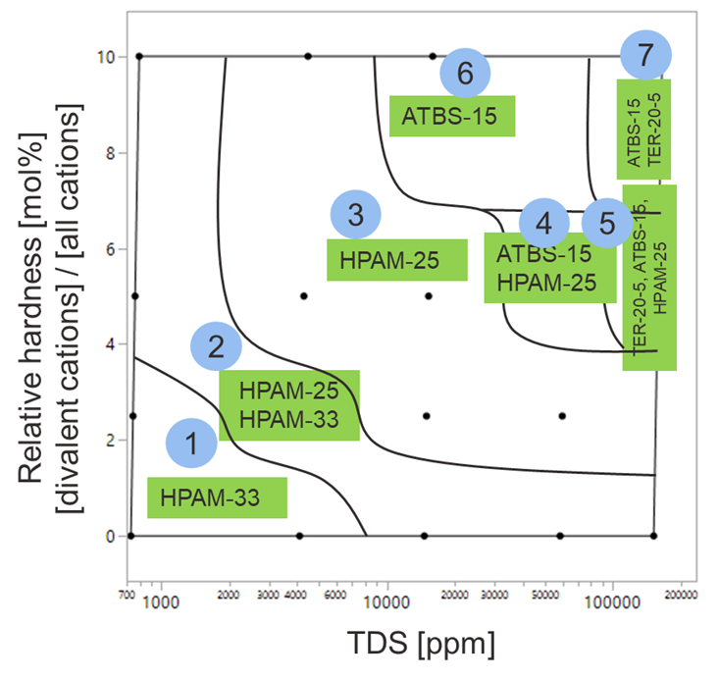
Viscosity yield
Multiple samples, 60°C
Areas 1-7 in the salinity map show different product candidates as highest viscosity option at 60°C
  Nurmi et al. 2023, EAGE IOR+
In practice, polimer selection is not onlybased on initial viscosity yield
  Thermal stability
  Performance in produced water
  Retention, injectivity etc.

Slide 11
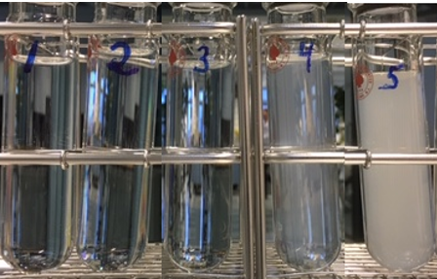
Cloud point
Temperature at which polymer starts to precipitate out from the brine
Dependent on TDS, hardness and polymer’s chemical composition
Temperature increases

Slide 12
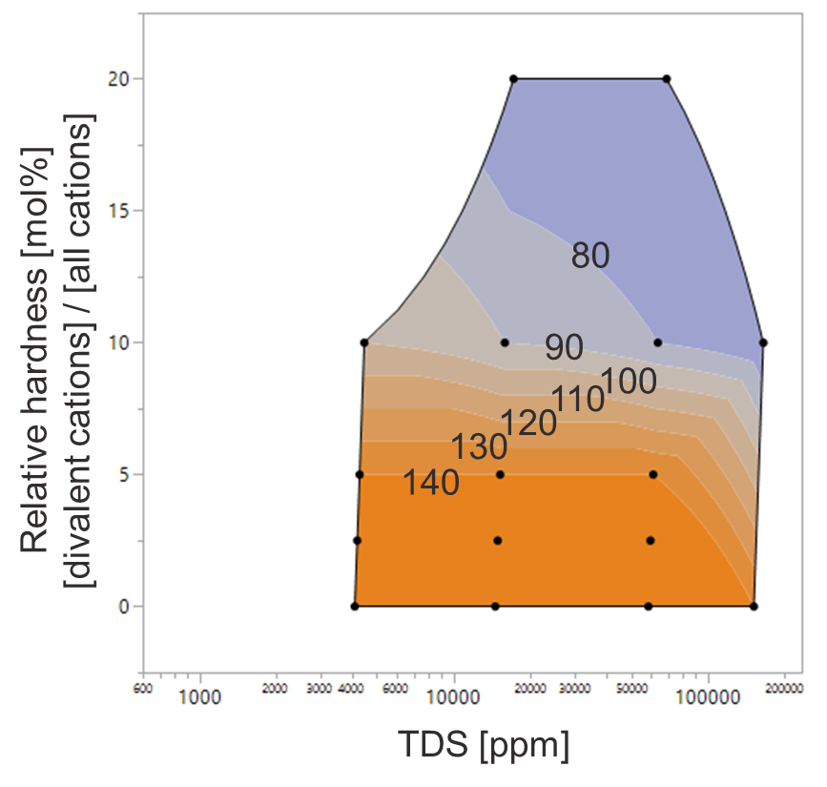
Cloud point
HPAM-25
Effect of brine composition to HPAM-25 cloud point
At moderate reservoir temperature (50-60°C) good solubility within reservoir expected in all tested brine compositions
  BUT deposit challenges may occur if temperatures above cloud point reached in produced water treatment – e.g. at heat exchangers

Slide 13
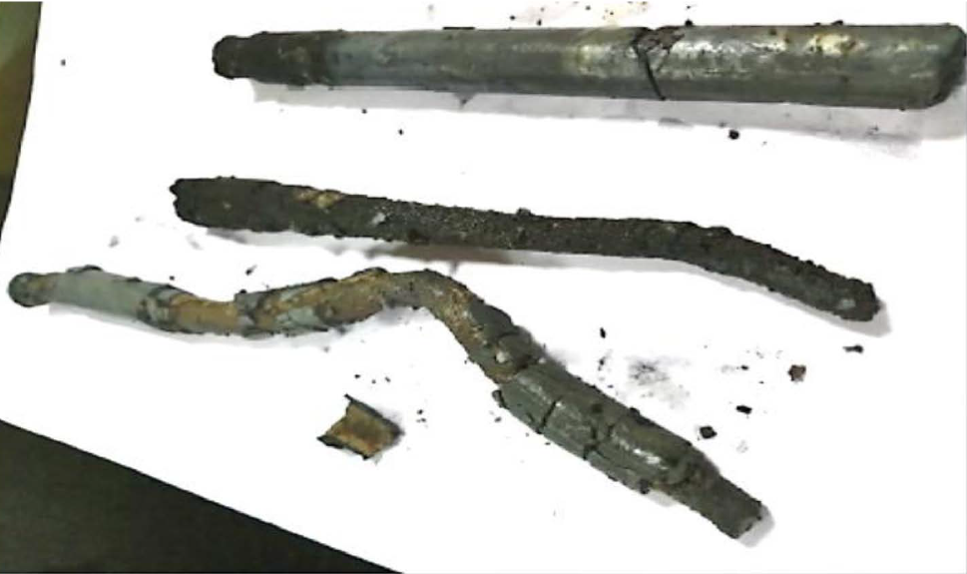
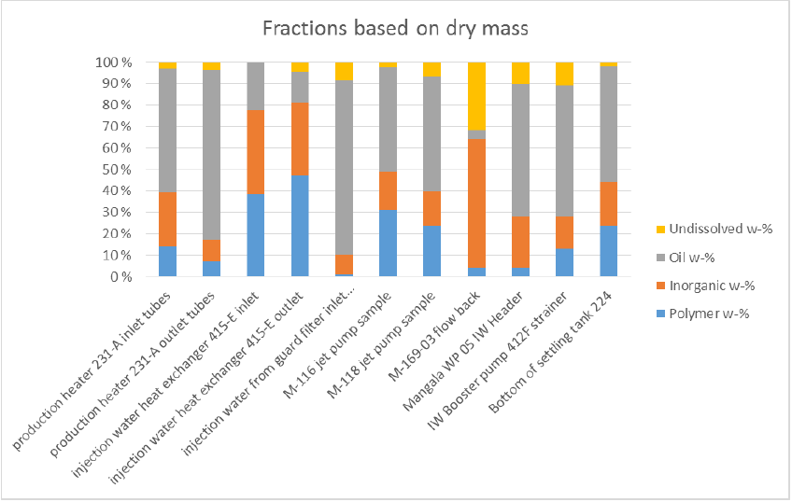
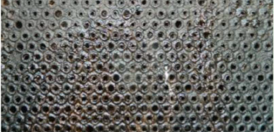
Examples of fouling at heat exchanger
Polymer reaches the cloud point at the heat exchanger temperatures
Injection water heat exchanger, Mittal, S. et al. SPE-192943-MS
Outlet plate of a heat exchanger, Zagitov, R. et al. SPE-194689-MS

Slide 14
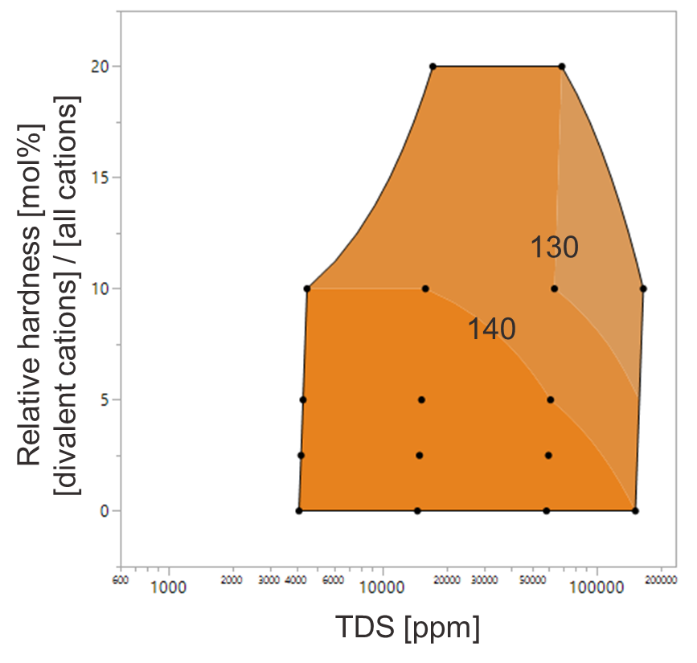
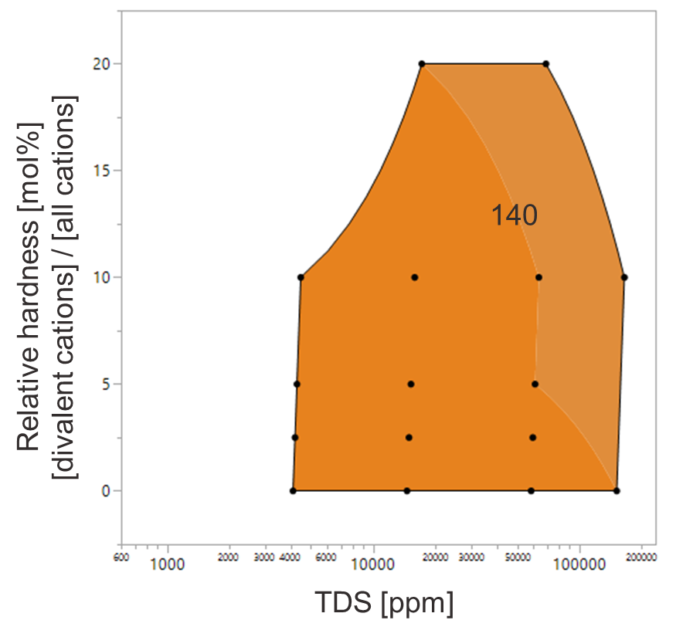
Cloud point
Cloud point related deposit risks in produced water treatment can be mitigated with right selection of injected polymer chemistry
  Applicable mainly at moderate temperatures (below 50-60°C) → polymer chemical composition is expected to be stable from injector to producer
HPAM-25
HPAM-20
TER-20-5

Slide 15

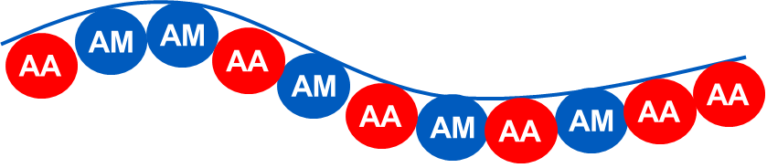
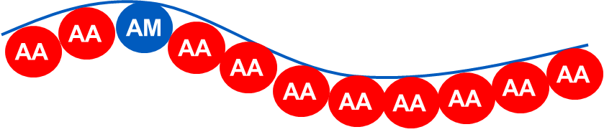
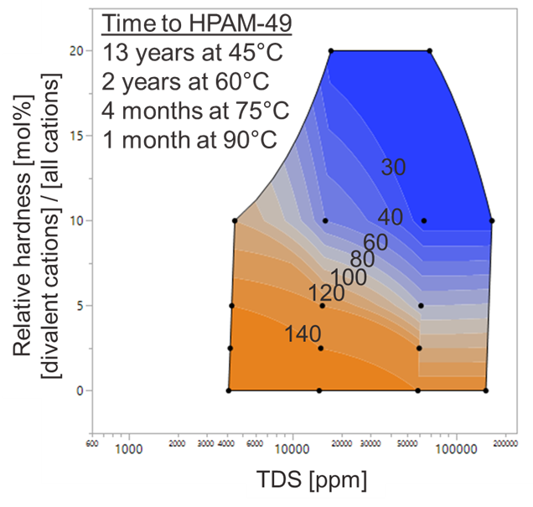
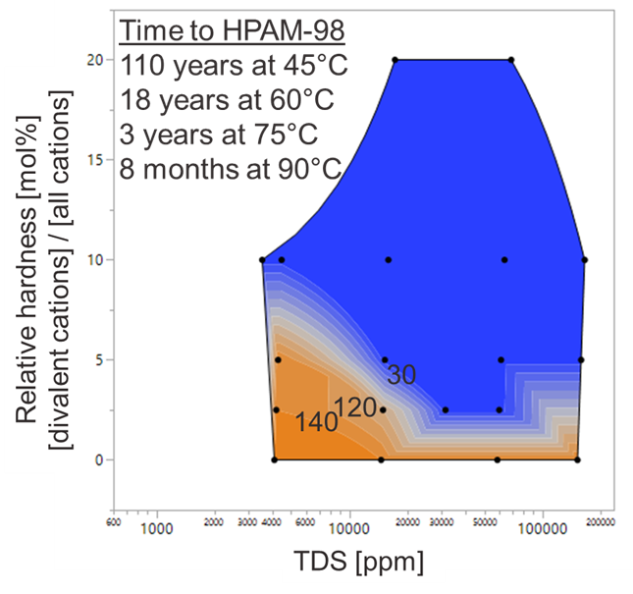
Cloud point
Hydrolysis rate at any temperature:
L.Nurmi et al. SPE-190184-MS
At high reservoir temperature → Hydrolysis decreases cloud point
  Increased risk for deposits in produced water treatment
  Sulfonation helps
HPAM-25
HPAM-49
HPAM-98

Slide 16
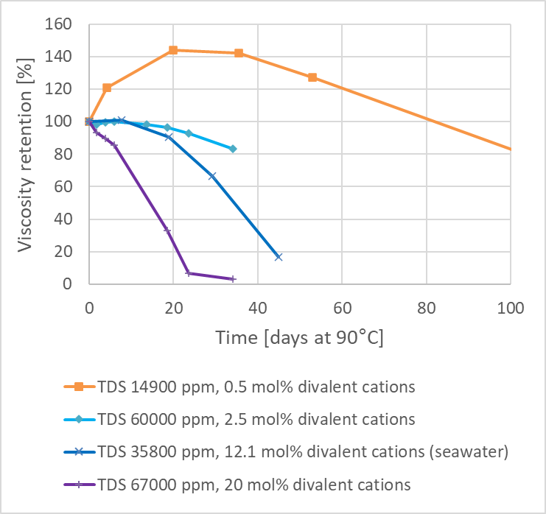
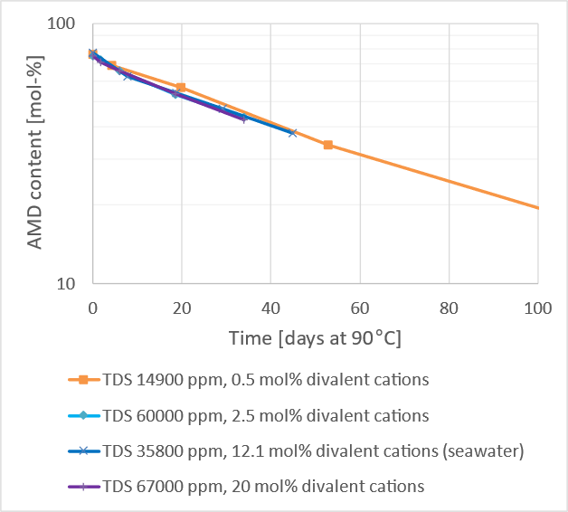
Thermal stability - Viscosity retention
Important at high reservoir temperature (above 50-60°C)​
How much viscosity [%] is retained after HPAM-25 hydrolysis?
Brine composition has big impact on viscosity retention
Brine composition does not have (major) impact on hydrolysis rate in typical EOR brines.
L.Nurmi et al. EAGE IOR 2019

Slide 17
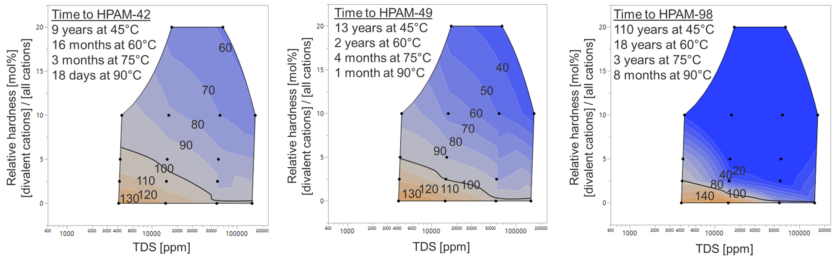
Thermal stability - Viscosity retention
Important at high reservoir temperature (above 50-60°C)​
How much viscosity [%] is retained after HPAM-25 hydrolysis?
Effect of brine composition on thermal stability
HPAM-25
HPAM-42
HPAM-49
HPAM-98
100%
Hydrolysis is beneficial at low TDS and hardness

Slide 18
Summary
Optimal chemical composition of polyacrylamide needs to be selected based on both reservoir and water treatment conditions
Systematic results provided to predict initial viscosity yield over a range of polyacrylamide products and conditions (TDS 700- 170 000 ppm, T up to 90°C)
Effect of brine composition to cloud point shown for a range of polyacrylamide products → exceeding cloud point at produced water treatment can be avoided with careful product selection
Systematic results provided for HPAM to predict thermal stability over a wide range of conditions (TDS 700 - 170 000 ppm, T up to 120°C)

Slide 19
Thank you

