Slide 1


Case Histories of Flow regulator Valves with Fixed Regulators in Selective Injection Waterflooding to Improve Secondary Recovery in mature fields
Jairo Zapata, John Gonzales, Camilo Gomez, Claudia Leal, (SIERRACOL); Juan P. Torne (JPT)

Slide 2
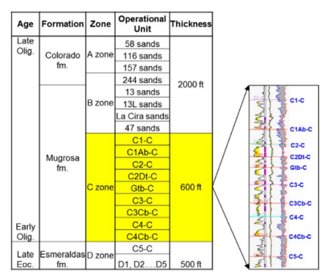
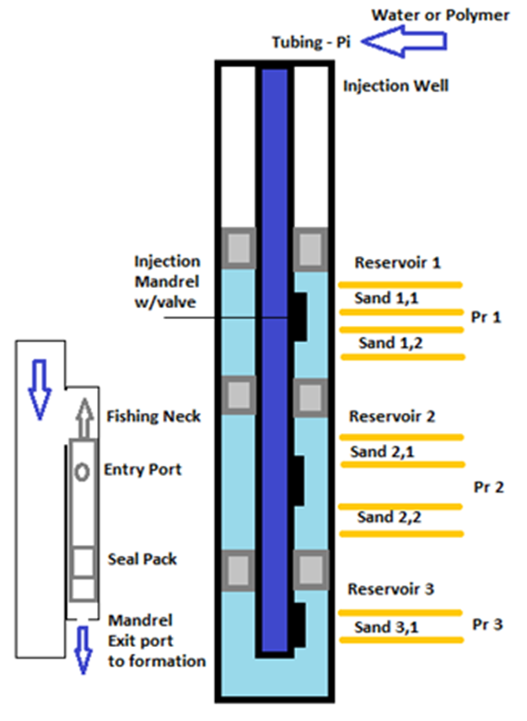
Introduction
Multilayer field
Selective injection

Slide 3
Introduction
Multilayer field
Selective injection
The control of water injection in secondary recovery processes in multilayer reservoirs is crucial to optimize and control the process to maintain reservoir pressure, displace residual oil and sustaining production from oil fields. Injection control and monitoring technology for surface and downhole have been developed, focused on procedures to maintain vertical efficiency and cost control which is critical for mature fields.

Slide 4
Introduction
Optimization Cost through regulators valves improvement
Association between Ecopetrol S.A ICP and the Casabe Field Engineering Management and JPT consulting
Review valve design to improve
      Injection efficiency
      Manufacturing processes associated with operation and maintenance.
      Injection Well Stability
Proposal
  Using multiple reducers in tandem to allow the pressure drop to be controlled (inlet pressure minus outlet pressure) by inserting expansion chambers or "dampers," which is a technique used to reduce vibrations and stabilize the response of injection systems.
  Software development for selecting the size of the chokes to control the injection rate according to the reservoir parameters and the requirements from reservoir engineer

Slide 5
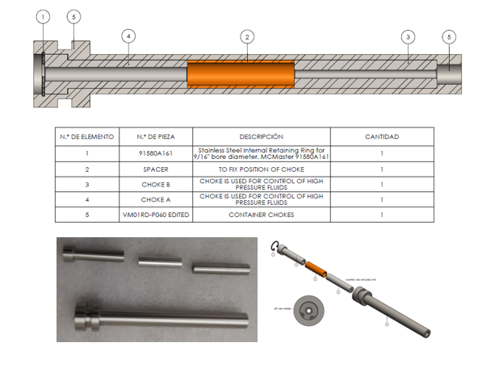
Injection regulator valves and different Modules
The system can be divided into injection modules. These modules use tandem chokes and spacers or dampers.
The improvements over conventional valves are mentioned below:
1. Valve parts optimization to reduce inventory and simplicity to minimize manufacture cost. Use of non-magnetic stainless steel to prevent oxidation and to extend useful life, optimizing operation cost.
2. Inlet and outlet parts to balance fluid volume and ease flow, designed with internal chambers to stabilize injection rates, minimize pressure changes and avoid abrupt injection changes.

Slide 6
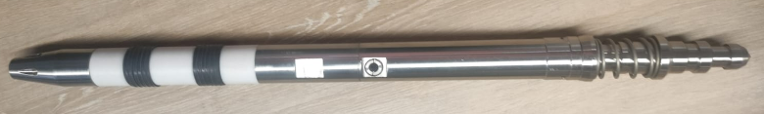
Injection regulator valves and different Modules
The system can be divided into injection modules. These modules use tandem chokes and spacers or dampers.
The improvements over conventional valves are mentioned below:
1. Valve parts optimization to reduce inventory and simplicity to minimize manufacture cost. Use of non-magnetic stainless steel to prevent oxidation and to extend useful life, optimizing operation cost.
2. Inlet and outlet parts to balance fluid volume and ease flow, designed with internal chambers to stabilize injection rates, minimize pressure changes and avoid abrupt injection changes.
3. Modular design allows multiple interchangeable internal modules for water or polymer injection, conversion to dummy valve, and use as measurement device. Conical guide nose with multiple fluid outlets and internal dart system to prevent backflow
4. Wide seal area for multiple setup of V-pack to improve sealing in old side pocket mandrels that could be worn or corroded

Slide 7
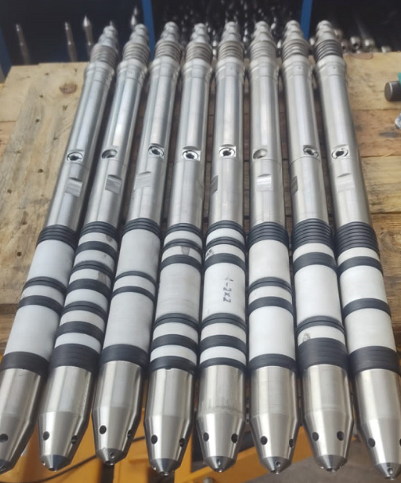
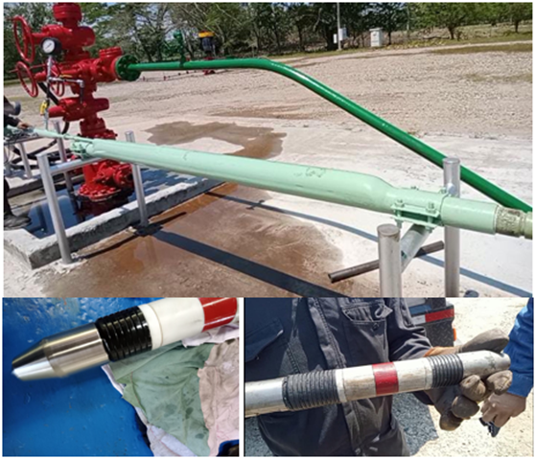
Multiple Tests and Hardware Description
Valves tests to confirm performance and verify proper seal, use multiple V-pack, each one can hold up to 1000psi differential pressure (rule of thumb)
Variable and multiple seal area configurations option, this is important for old mandrels (corrosion)
Improved fishing collar/fishing neck which is stronger 1.5 to 2 times with respect to standard ones
Inflow protector rings and reductors holder to minimize any damage to the valve body extending run-life
Improved internal flow balance and guide nose with multiple orifices and backflow control dart system incorporated to the valve optimizing operations

Slide 8
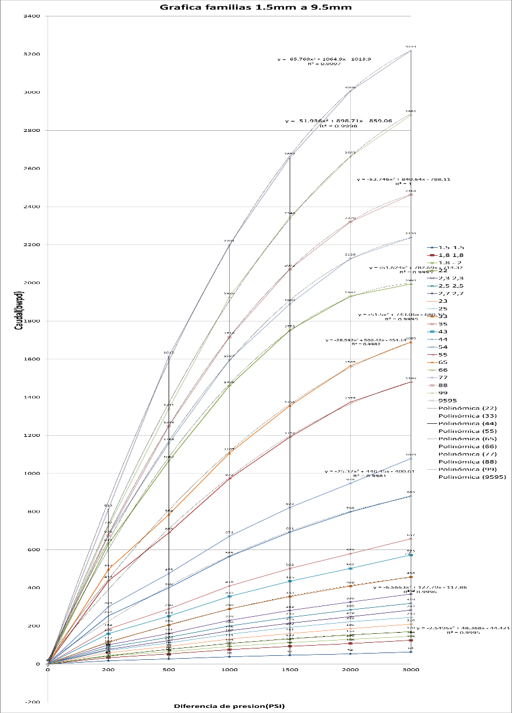
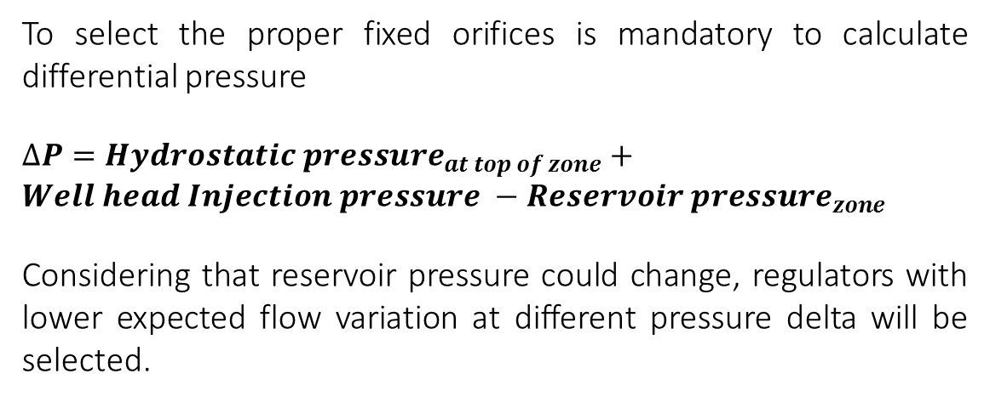
Design charts to select injection valve
Experimental tests of prototypes were made that were positive based on the trials and simulation to establish models and correction curves which permit the design and prediction of the response according to the requirements of rate and pressure for each zone determined by reservoir engineer, selecting the proper size of the tandem reducers required.
To select the proper fixed orifices is mandatory to calculate differential pressure
$∆P={Hydrostatic pressure}_{at top of zone}+Well head Injection pressure −$ ${Reservoir pressure}_{zone}$
Considering that reservoir pressure could change, regulators with lower expected flow variation at different pressure delta will be selected.

Slide 9
Field Test Methodology

Slide 10
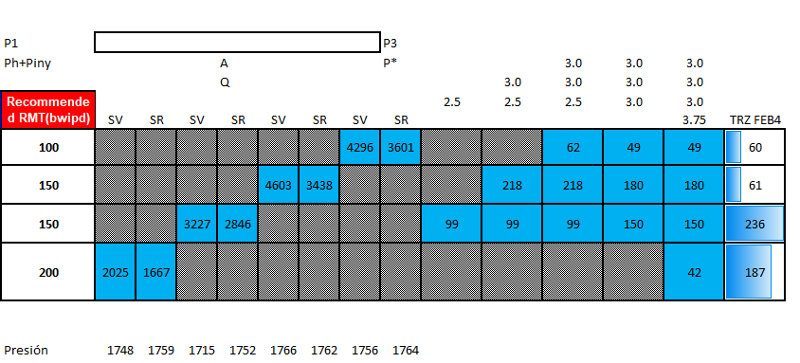
Phase 1 – Individual zone test
Sierracol considers that the estimation of injection potential on each zone is relevant to understand injection performance. In order to acquire this information, the zones are tested individually.
The zones out of the study should be isolated installing Dummy valve in their side pocket mandrels to allow injection through the mandrel of interest.
Gray color represents the installation of Dummy valve
Blue color zone of study

Slide 11
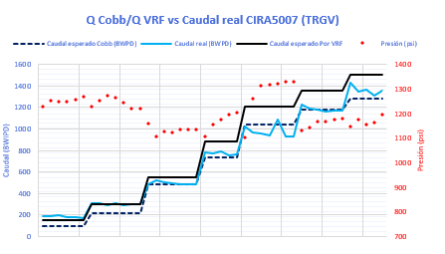
Phase 2 – Cumulative injection test
The next step is the installation of the selected valves and the measurement of flow rate after each one of the them has been installed. The assumption is that the flow rate should increase within each installation and the difference between the last measurement and the previous measurement corresponds to the flow rate in the last zone where the valve is being installed. Hence the name cumulative test.
Expected rate
Measured pressure
Measured rate

Slide 12
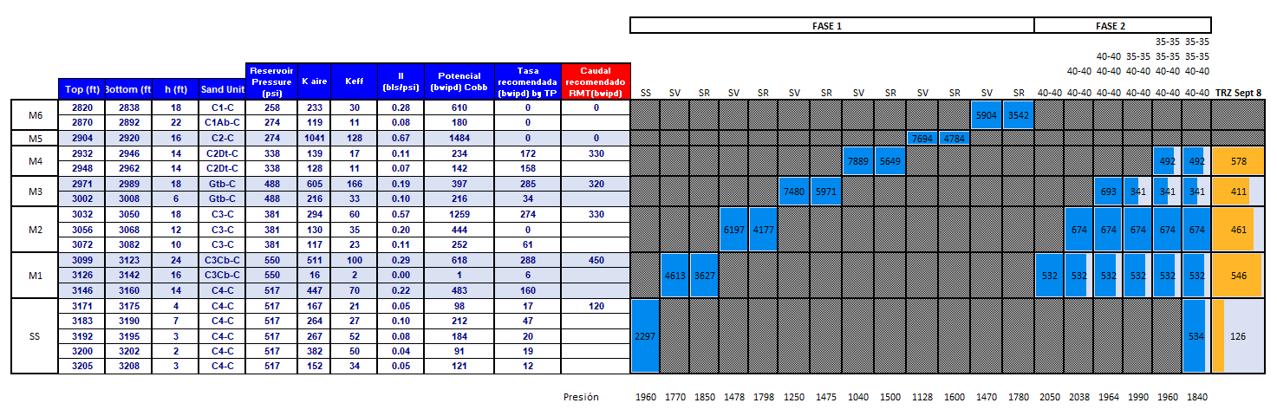
Phase 2 – Cumulative injection test
The advantages of this methodology are listed below:
Measured flow rates could be similar to an injection tracer
The fixed orifices could be changed if the flow rate doesn’t initially adjust to expect flow rate.
This will allow vertical efficiency improvement by selecting and installing proper valves according to their response and reduce operational cost.

Slide 13
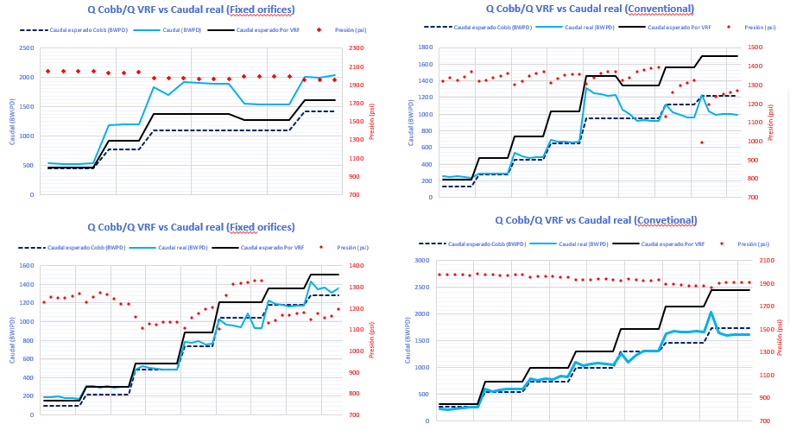
Valves performance comparison using Sierracol’s methodology
Results show injection stability using fixed orifices valves

Slide 14
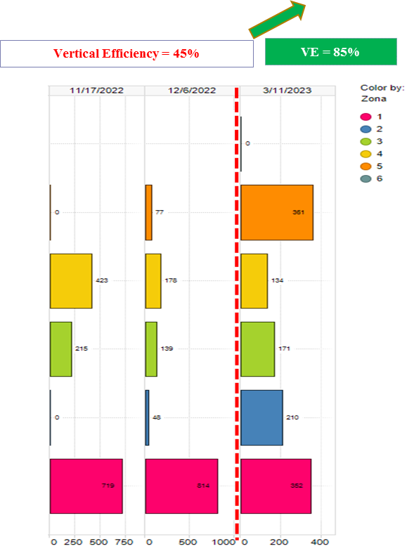
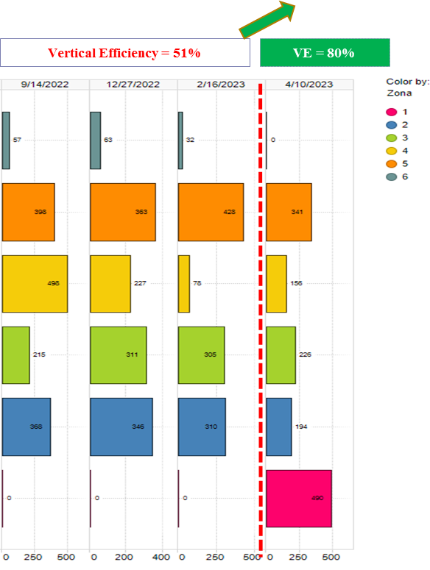
Vertical injection improvement
Well 1
Well 2

Slide 15
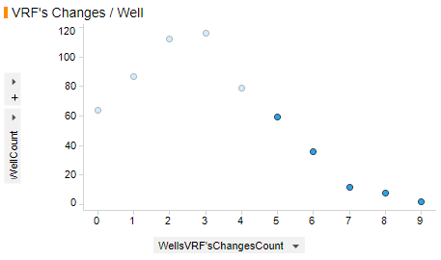
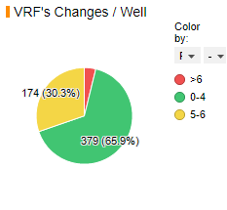
Performance Analysis
Well | VRF technology | Vertical Efficiency | VRF changes required after last installation
Well 1 | Fixed Orifices | 85% | 0
Well 2 | Fixed Orifices | 78% | 0
Well 3 | Fixed Orifices | 70% | 0
Well 4 | Conventional | 46% | 1
Well 5 | Conventional | 41% | 1
Well 6 | Conventional | 34% | 1
Vertical efficiency improvement implies less VRF changes.
Sierracol’s target is to reduce VRF changes per year to decrease operational cost.

Slide 16
SUMMARY
The new valve technology using fixed orifice in tandem with Sierracol Energy's methodology of orifice selection is a step change in improving vertical efficiency from an average of 50% to more than 80%, a more considerable reduction in valve replacement for at least one year, better well stability with less fluid losses thru specific zones, and optimize and reduce operating cost, inventory, and maintenance expenses.
Vertical efficiency improvement implies increase in the recovery factor and less valves changes. The valves are replaced if it does not reach the desired rate. That is why wells with low vertical efficiency usually have more than 4 entries per year (as shown in Figure 12 for the conventional technology). The reduction in changes per well implies a re reduction in operational costs. The valve selection using Sierracol’s methodology has shown a better approach to reach the injection rate using the differential pressure.
The individual test zone has allowed us to identify the injection potential of each zone, especially those zones with low injectivity. This way, costs will be reduced, avoiding unnecessary valve changes.
The valve technology and its selection methodology have fulfilled the objective of improving efficiency at a lower cost, including fewer parts and inventory costs, better manufacturing and assembly quality, local manufacturing, longer injection stability in the wells, less slick line services and operating costs and even reducing the risk of well failure due to valve damages. All cost optimization and reduction, including local manufacturing, generally provide greater profitability in mature fields.

Slide 17
SPECIAL THANKS
Authors would like to thank Sierracol Energy, and JPT Consulting and Services for the permission to publish this paper and the organizers of this IAPG Conference.

