Slide 1
Evaluation of thermal stability and propagation of sulfonated polymers in high salinity and high temperature conditions
M. Hesampour, L. Bava, L. Nurmi, S. Hanski, K. Henttunen, N. Donnel, E. Pin
luciana.bava@kemira.com
erica.pin@kemira.com

Slide 2
Table of content
Introduction
Objectives
Methods and Materials
Results
Take away message

Slide 3
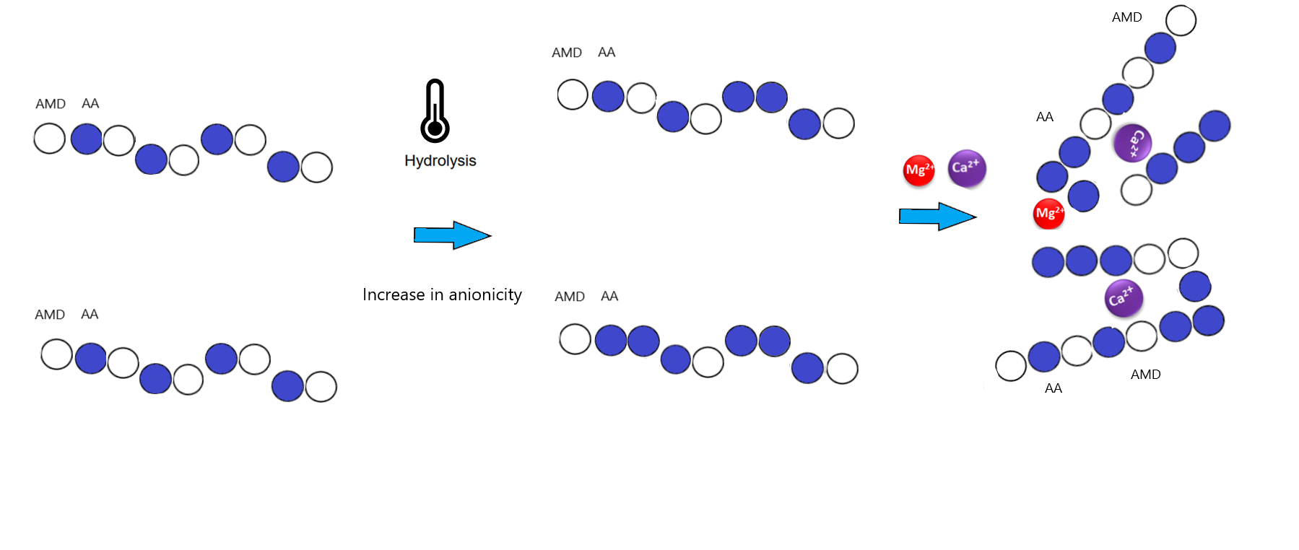
Theory – change in polymer properties in the reservoir

Slide 4
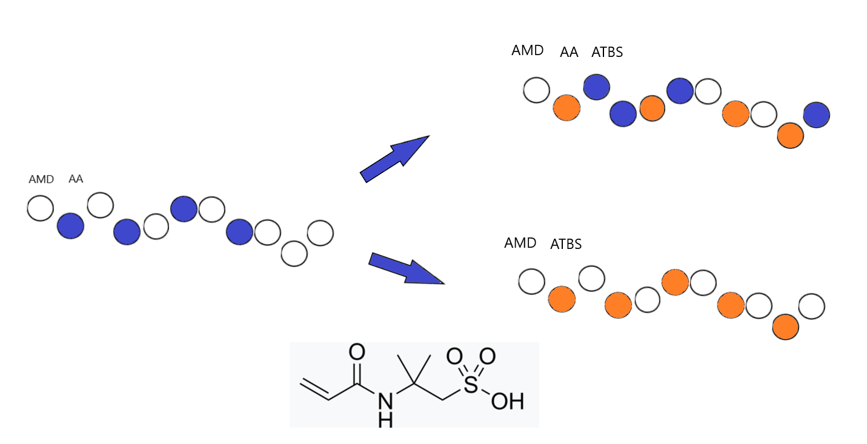
Theory – how to improve the polymer temp/salt tolerance
2-Acrylamido-2-Methylpropane Sulfonic Acid

Slide 5
Objectives
To investigate the thermal stability of highly sulfonated polymers in brines with very high salinity and establish a connection between accelerated thermal aging and regular thermal aging.
To explore the consequences of sulfonated polymer aging on its propagation and adsorption in the core

Slide 6
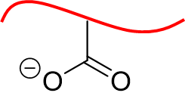
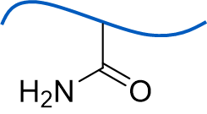
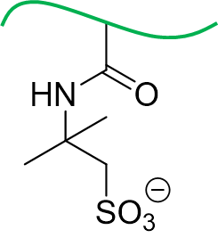
Methods and Materials 1/2
Polymer samples
Sample name | AMD (mol%) | AA (mol%) | ATBS (mol%)
HPAM-25 | 75 | 25 | 0
ATBS-25 | 75 | 0 | 25
ATBS-55 | 45 | 0 | 55
ATBS-90 | 10 | 0 | 90
ATBS-100 | 0 | 0 | 100
Acrylic acid
Acrylamide
ATBS
Brine compositions
Brine | TDS, ppm | Divalent, ppm | Na, ppm | K, ppm | Mg, ppm | Ca, ppm | Cl, ppm | SO4, ppm
Brine 1 | 179764 | 17743 | 49895 | 0 | 3246 | 14497 | 111891 | 234
Brine 2 | 33488 | 1614 | 10390 | 391 | 1093 | 521 | 18789 | 2304

Slide 7
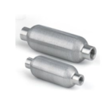
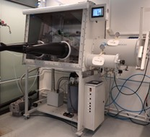
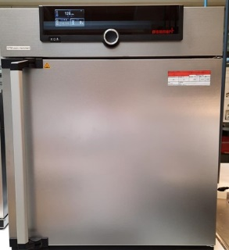
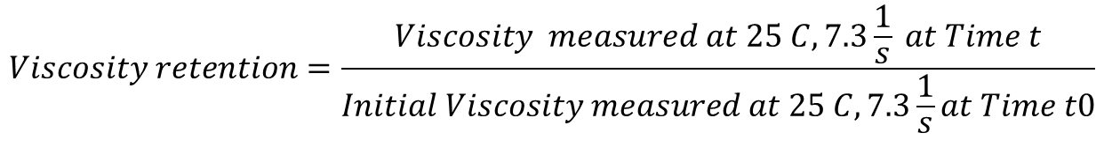
Methods and Materials 2/2
Thermal stability
Viscosity retention
Hydrolysis rate
$$Viscosity retention=\frac{Viscosity measured at 25 C, 7.3\frac{1}{s} at Time t}{\begin{aligned}Initial Viscosity measured at 25 C, 7.3\frac{1}{s}at Time t0 \\ \end{aligned}}$$
Nurmi et al. SPE-190184-MS

Slide 8
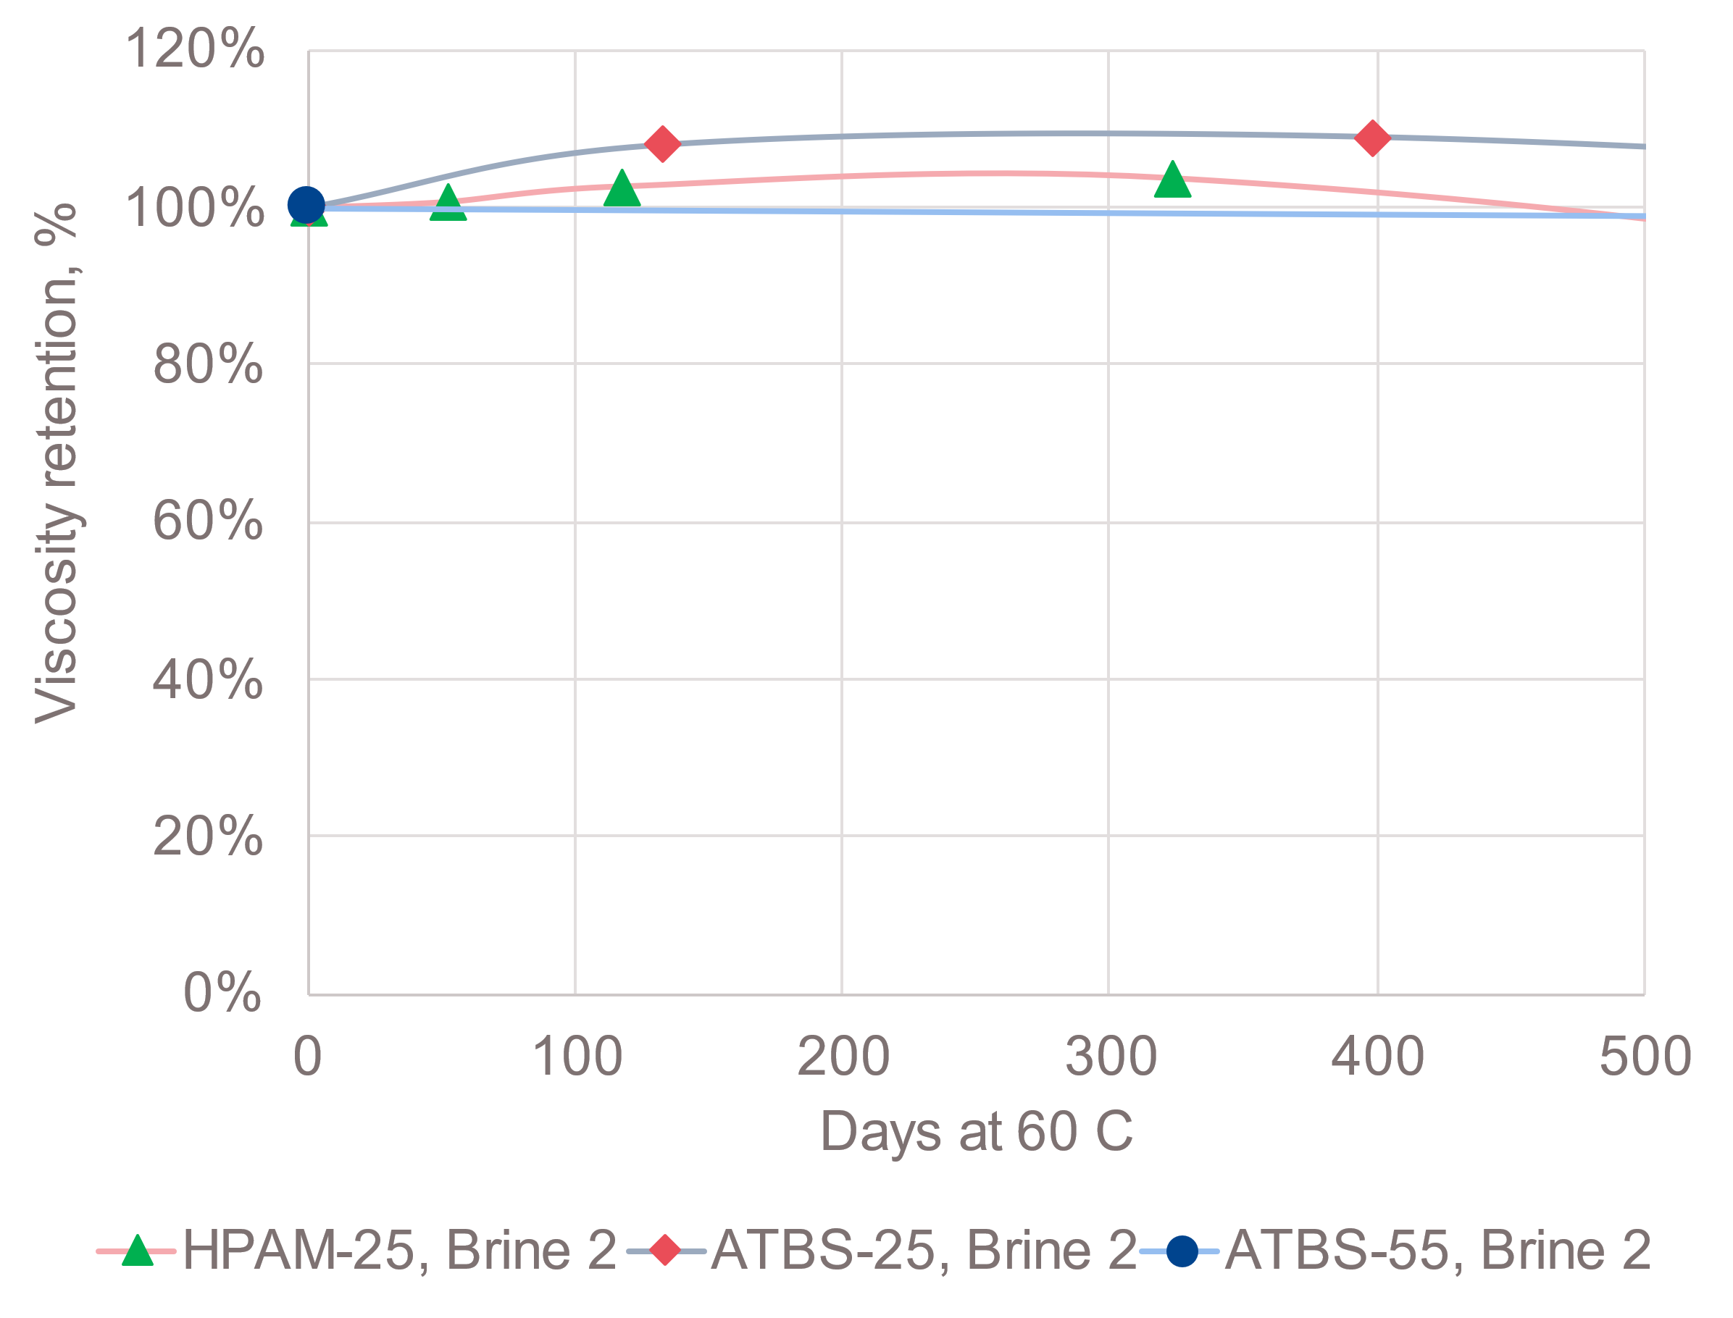
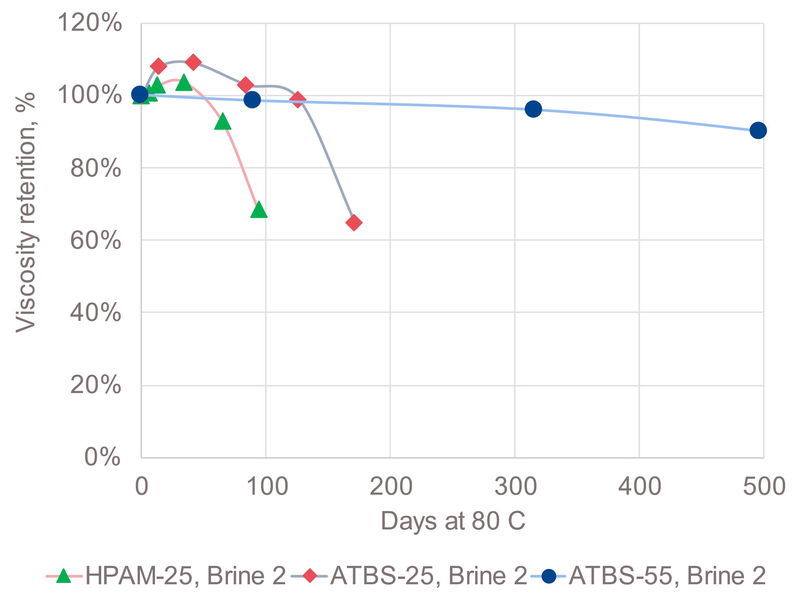
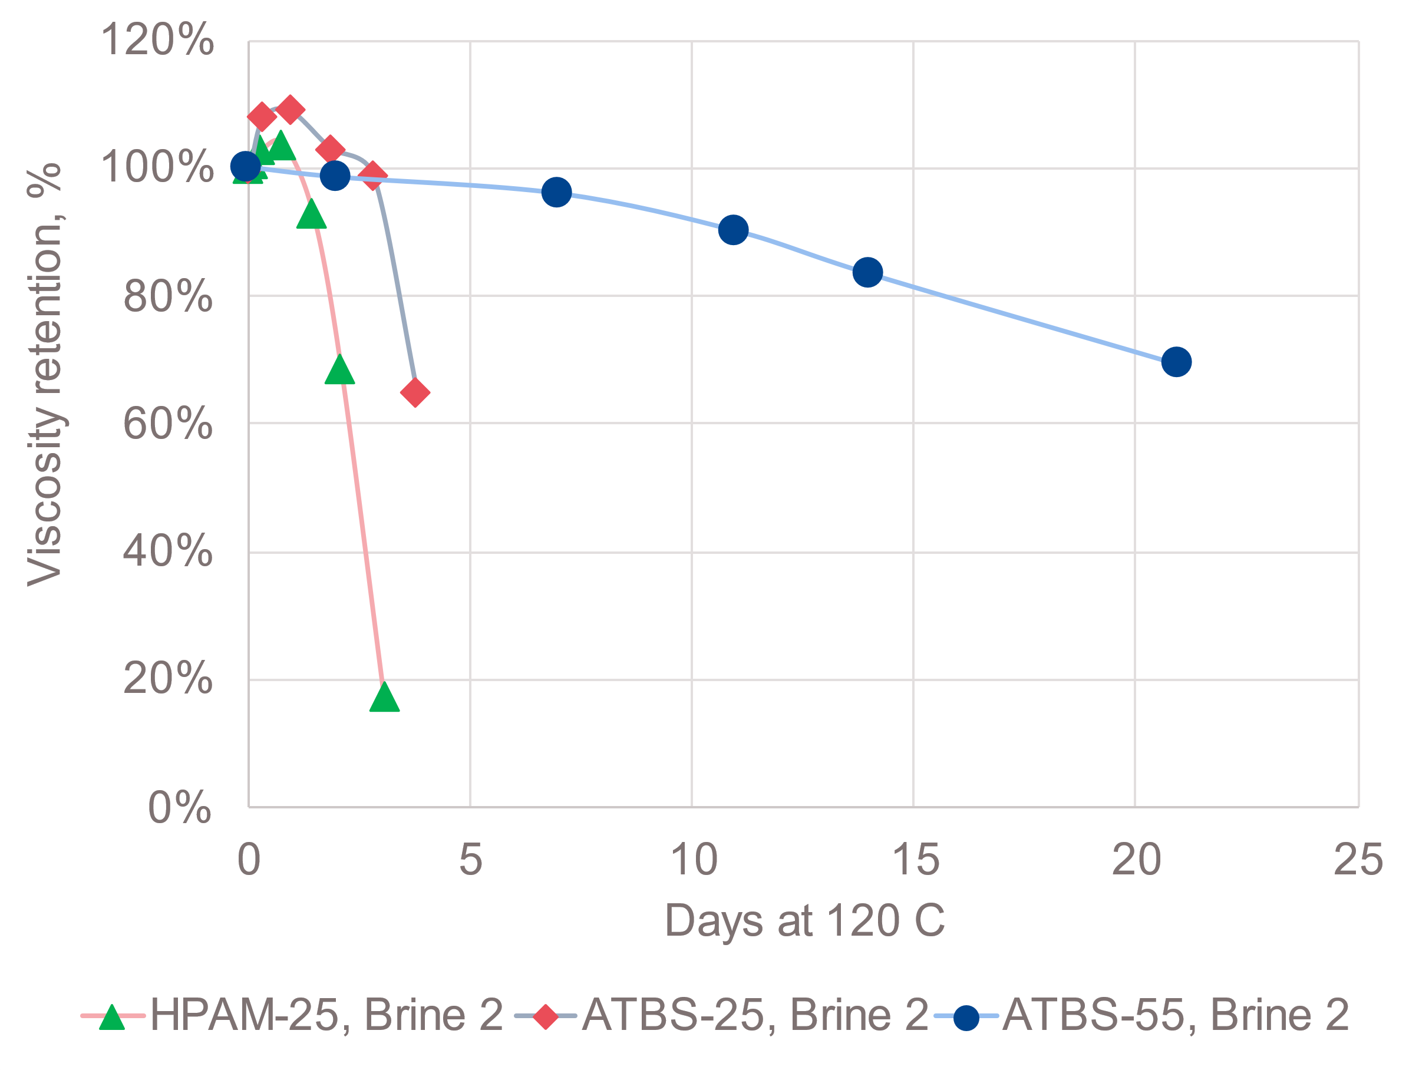
Results: Thermal stability - effect of temperature and sulfonation
Polymer stability depends on temperature.
Remarkable prolonged stability at lower temperature.
60 °C
80 °C
120 °C
Note difference in time scale

Slide 9
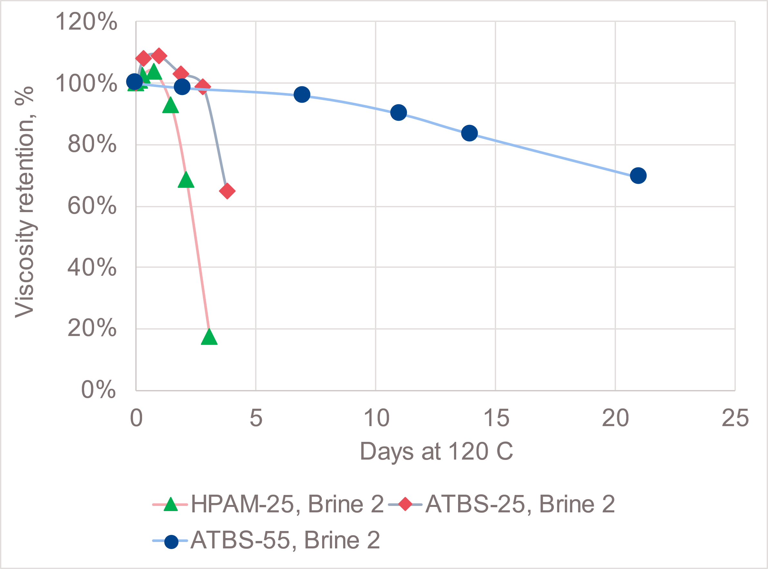
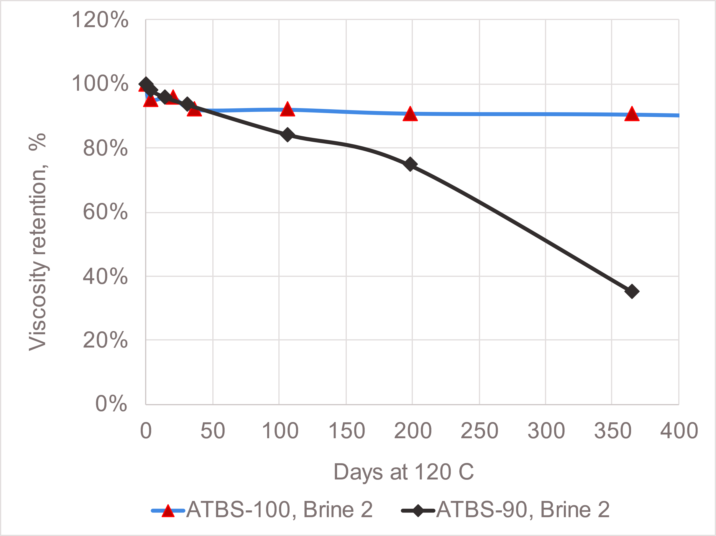
Results: Thermal stability at 120°C - effect of level of sulfonation
Remarkable prolonged stability in Brine 2 when ATBS content increases to 90% and above.
Low to medium level of sulfonation
High level of sulfonation
Note difference in time scale

Slide 10
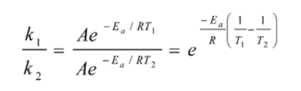

Thermal aging, accelerated vs. standard
Arrhenius equation
Ratio of reaction rate at two different temperature
Aging temperature, C | Reservoir temperature, C | Coefficient | Time (days) to get data for 1 year stability at reservoir temperature
140 | 120 | 5 | 73
140 | 80 | 230 | 1.5
120 | 80 | 45 | 8
120 | 60 | 429 | 0.85
Nurmi et al. SPE-190184-MS

Slide 11
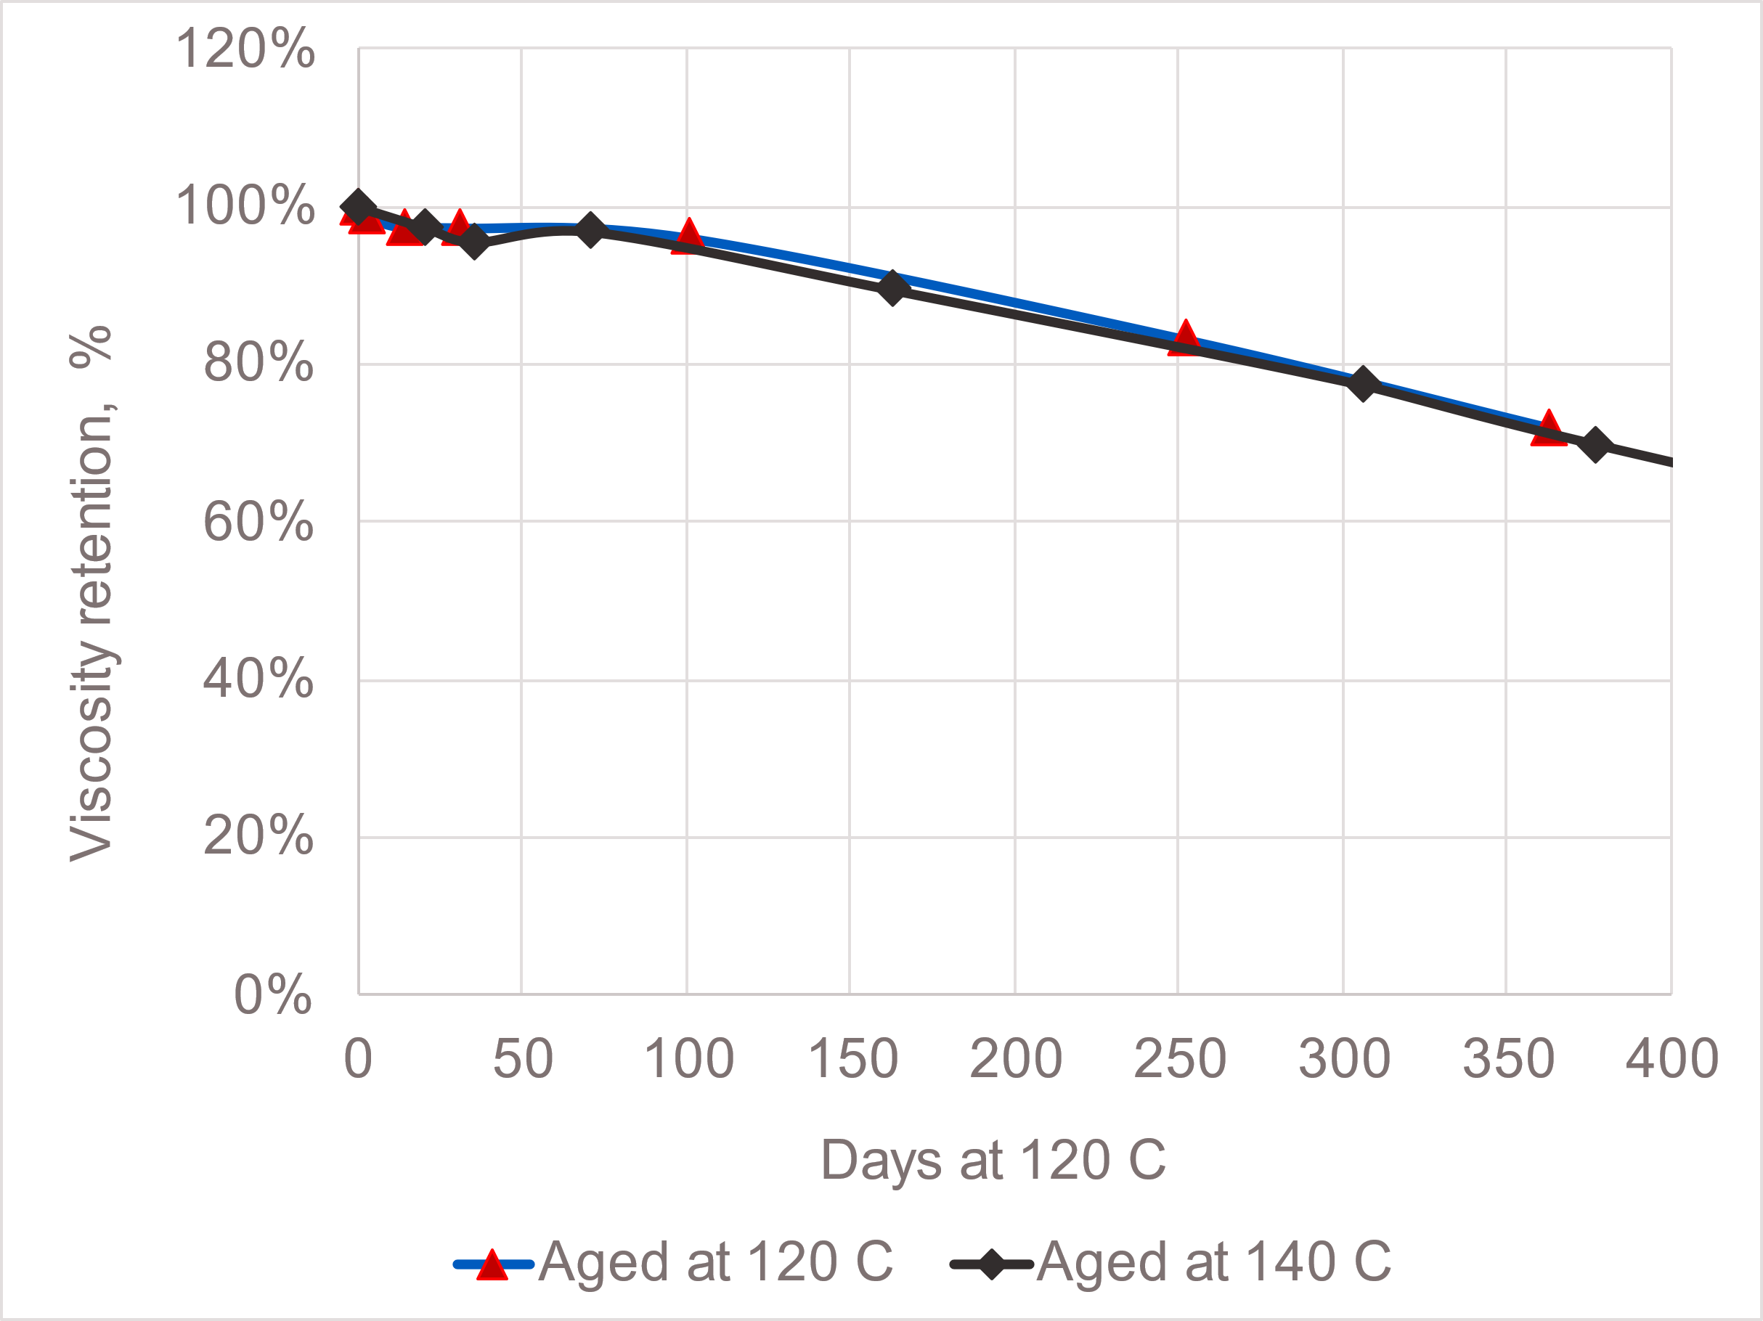
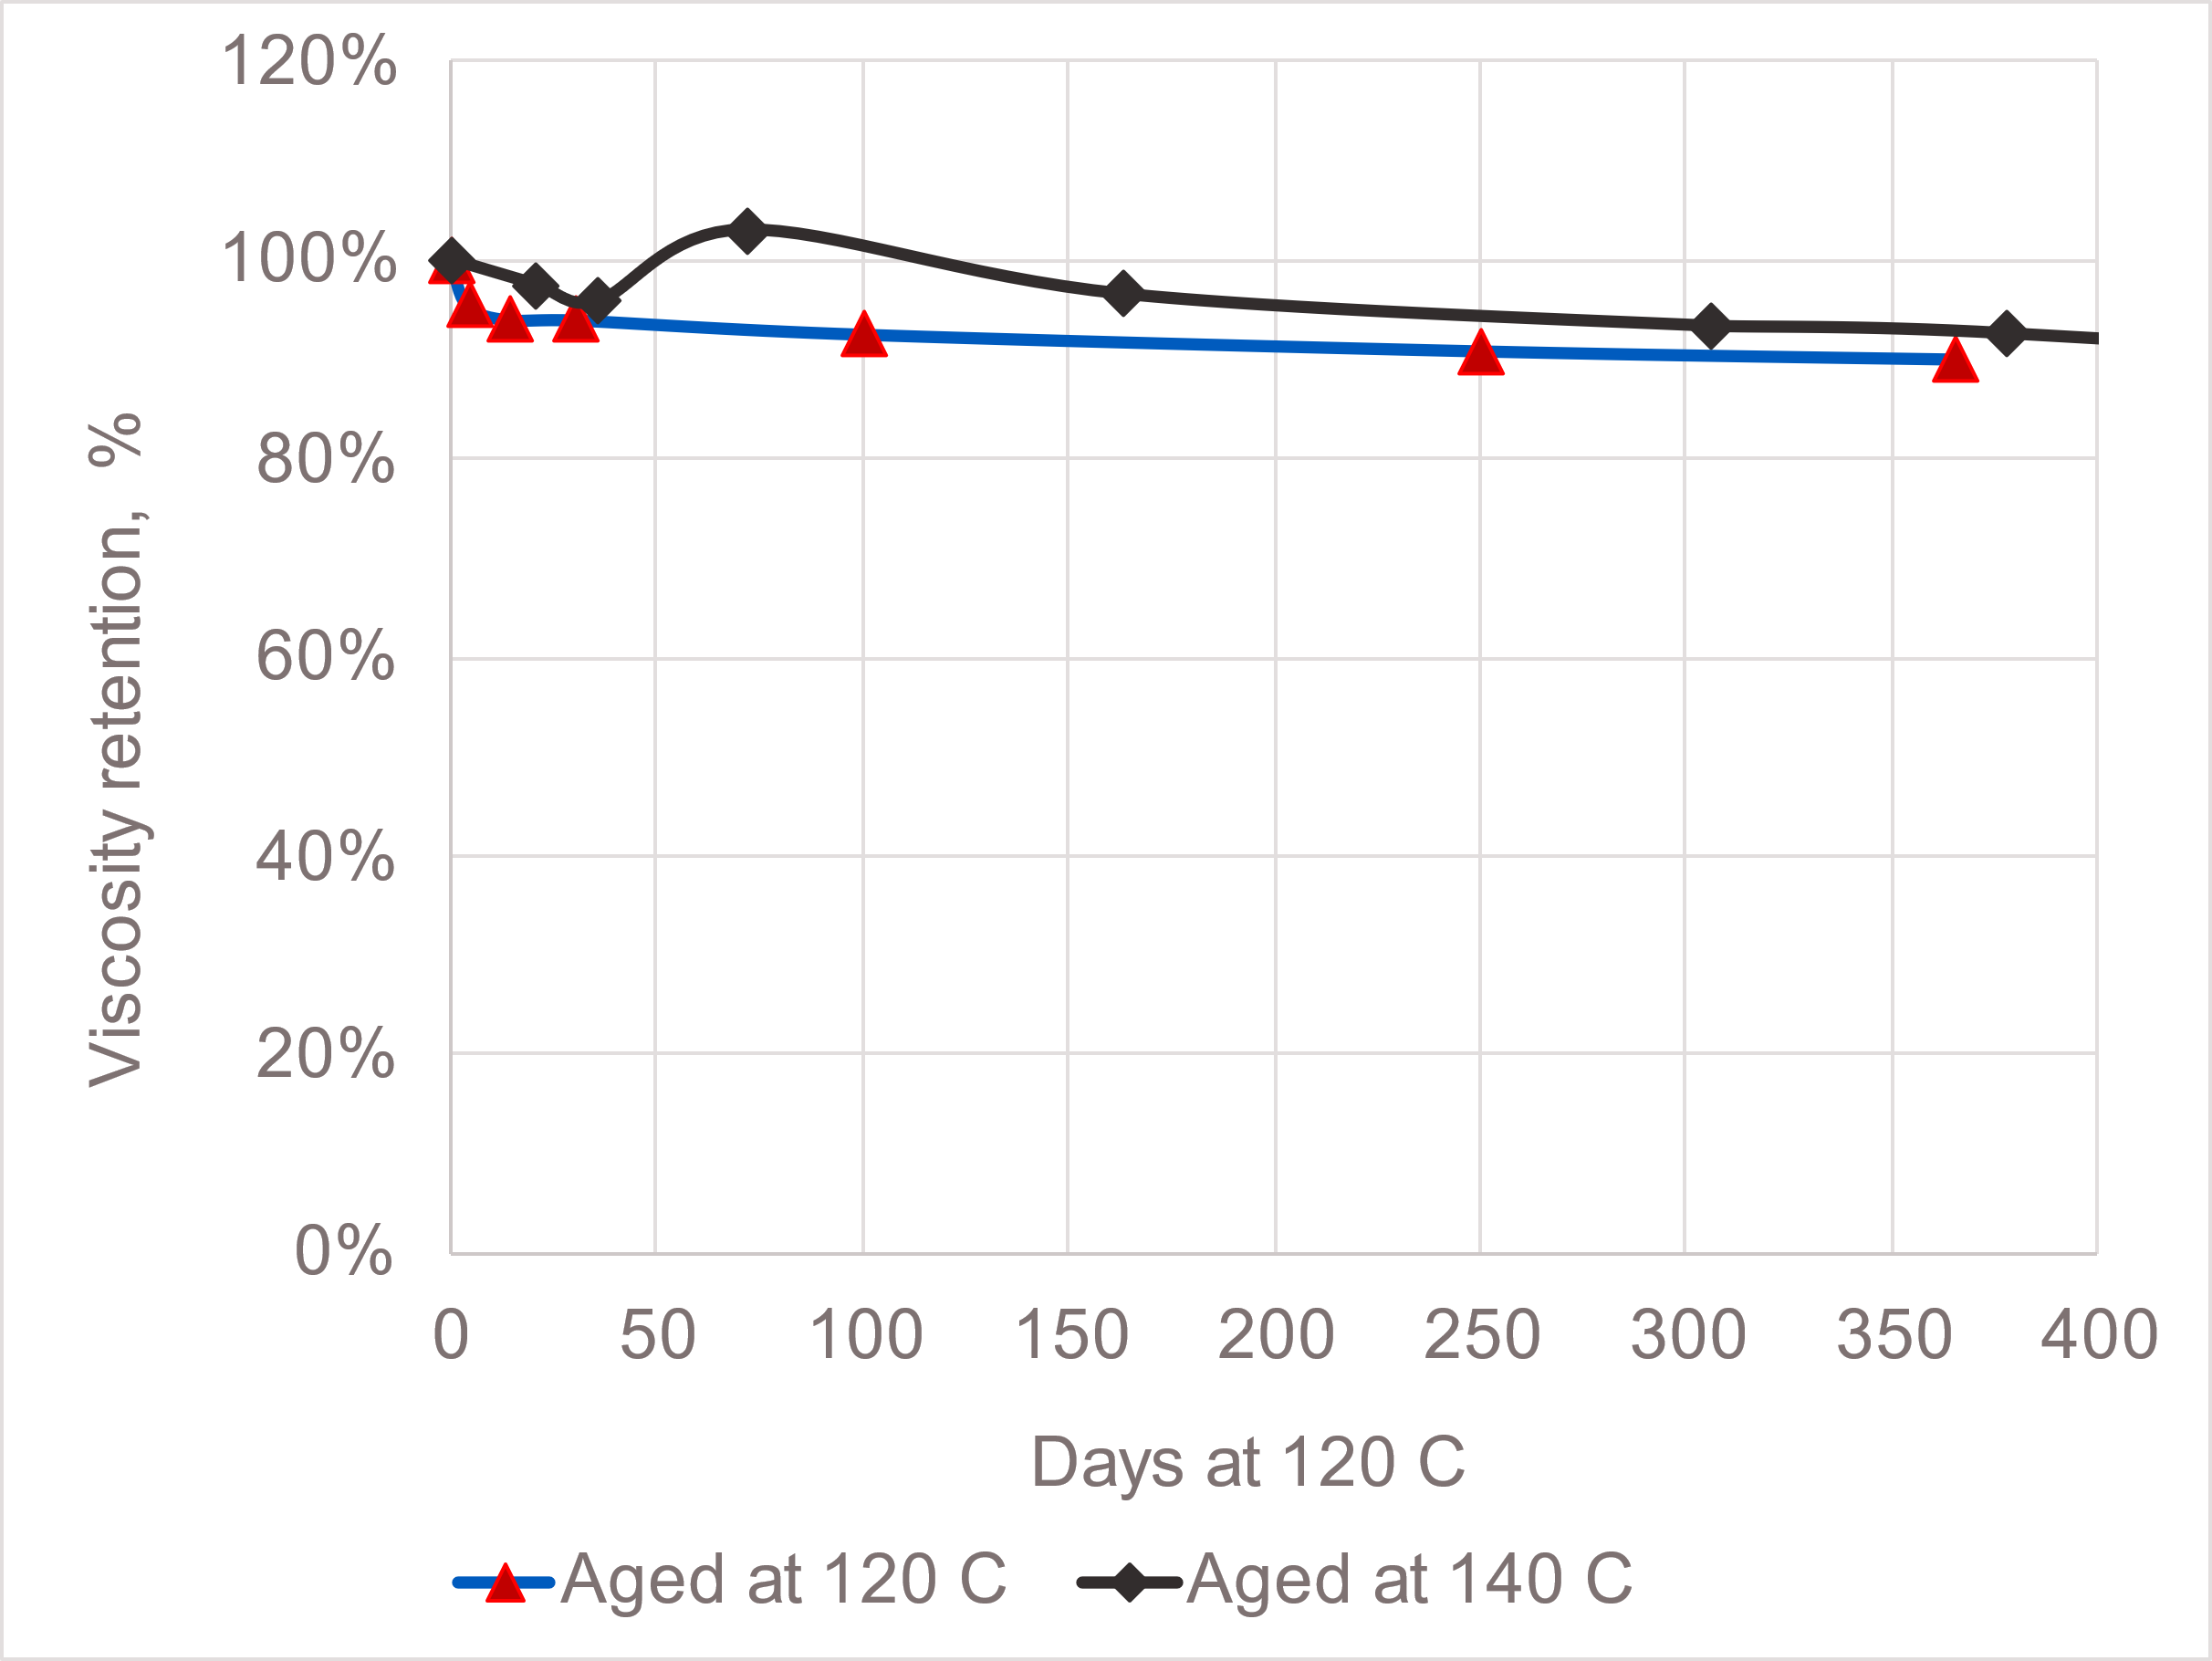
Results: ATBS-90 and ATBS-100, thermal stability, accelerated vs. standard
The alignment between the transferred data and the actual measurement data in Brine 1 validates the effectiveness of the approach.
ATBS-90
ATBS-100

Slide 12
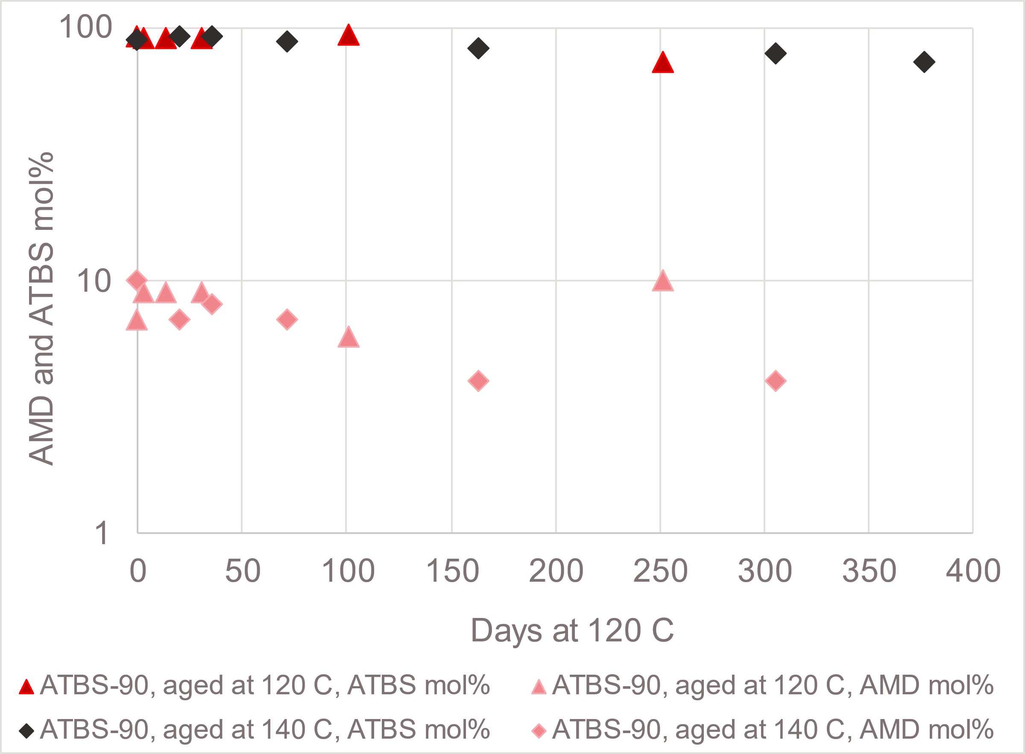
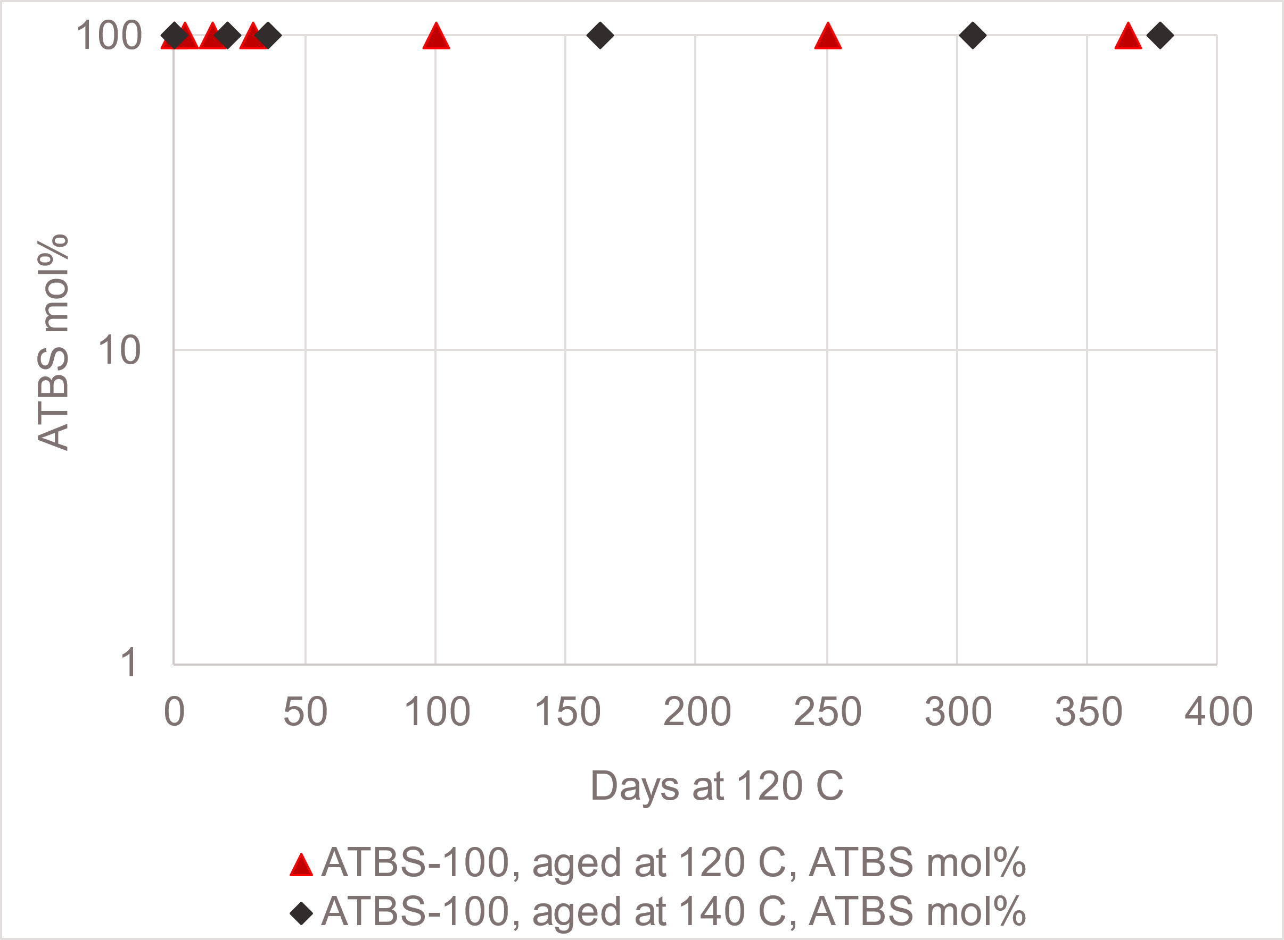
Results: ATBS-90, thermal stability, accelerated vs. standard
The alignment between the transferred data and the actual measurement data in Brine 1 validates the effectiveness of the approach.

Slide 13
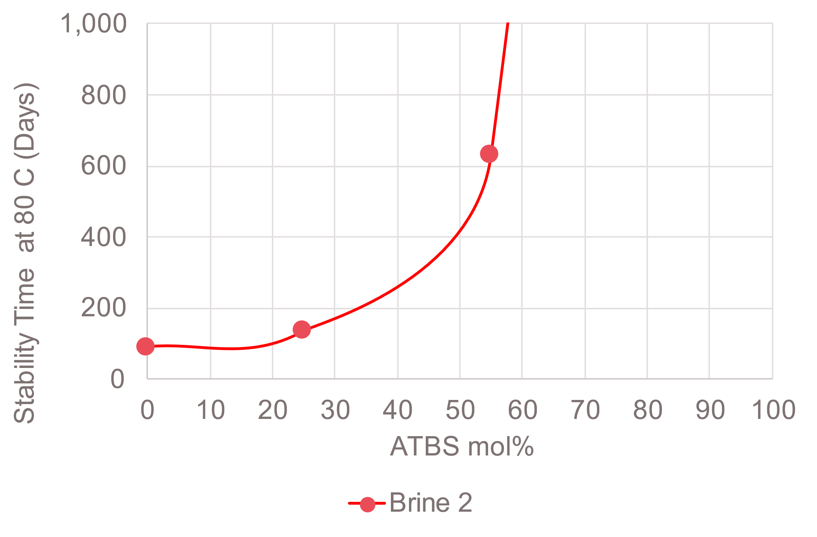
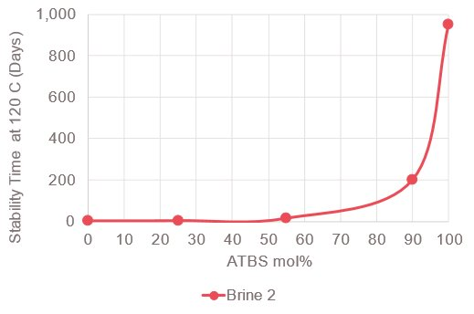
Results: Thermal stability of HPAM and sulfonated polymers
Stability time at viscosity retention of 80%
Long thermal stability for very high temperatures is obtained when ATBS content is equal or above 90%.

Slide 14
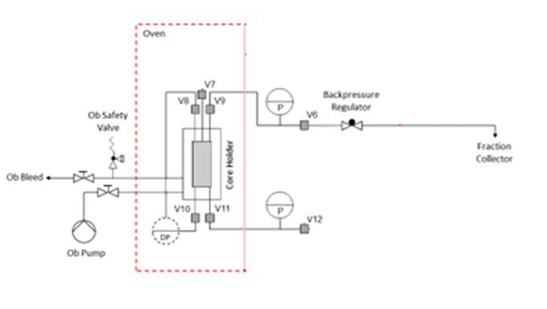
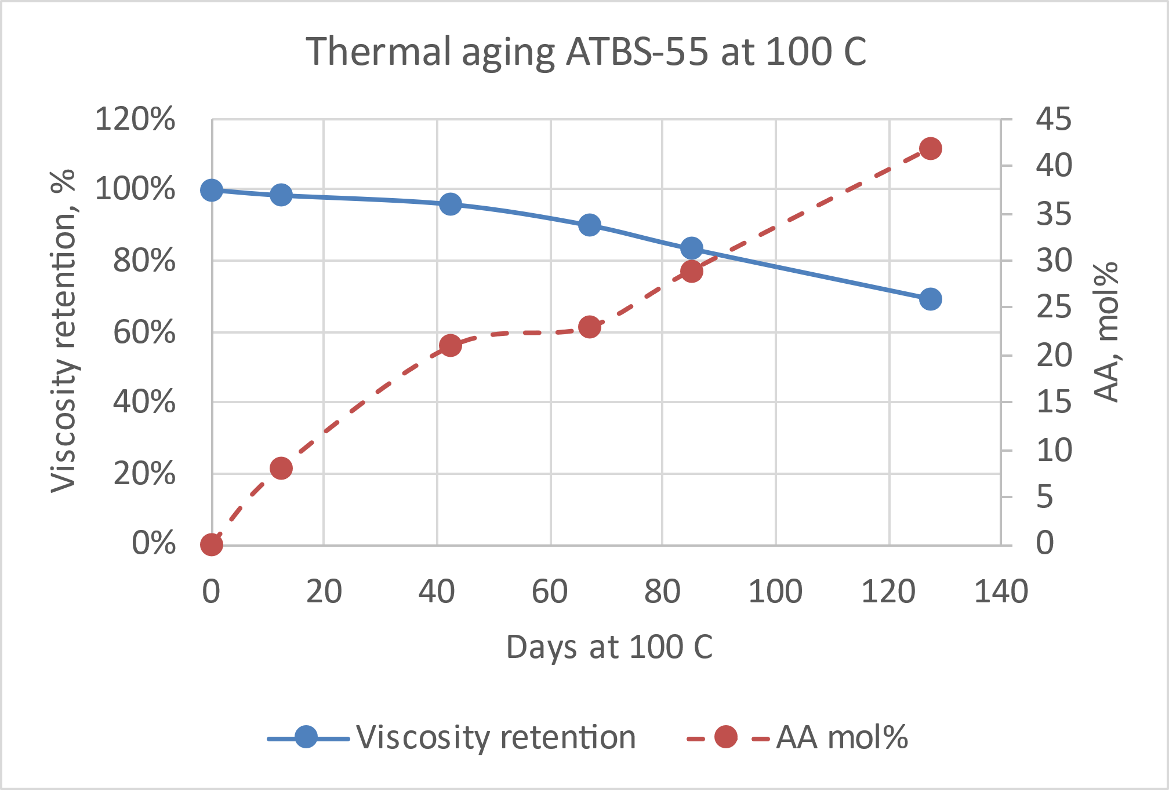
Core flooding
Injectivity (core flood)
Viscosity inside of pores(RF)
Injectivity
Fresh polymer: Co-polymer
AMD:45%, ATBS:55%
Aged polymer: Ter-polymer through hydrolysis
AMD: 20% ATBS: 55%, AA: 25%
Equivalent to product after ~3 months residence time in reservoir at 100 °C
The concentration of aged polymer adjusted to obtain similar injection viscosity as fresh polymer
Hesampour et al. 2023, EAGE IOR+

Slide 15
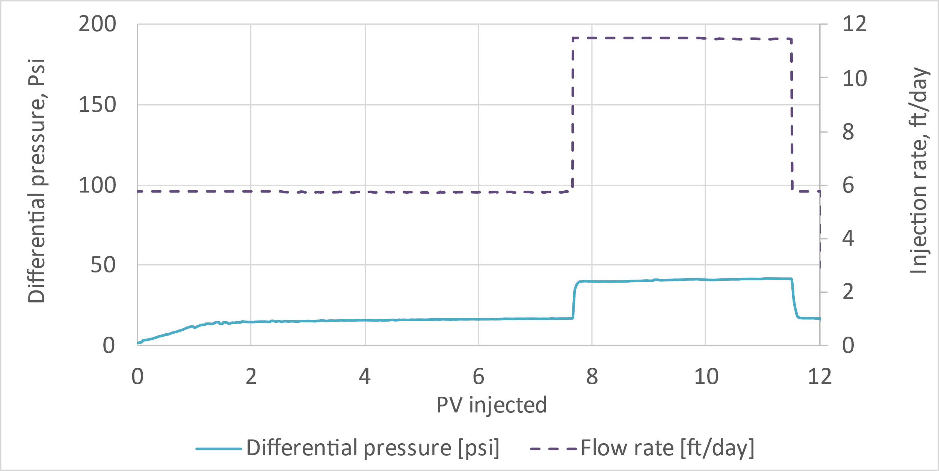
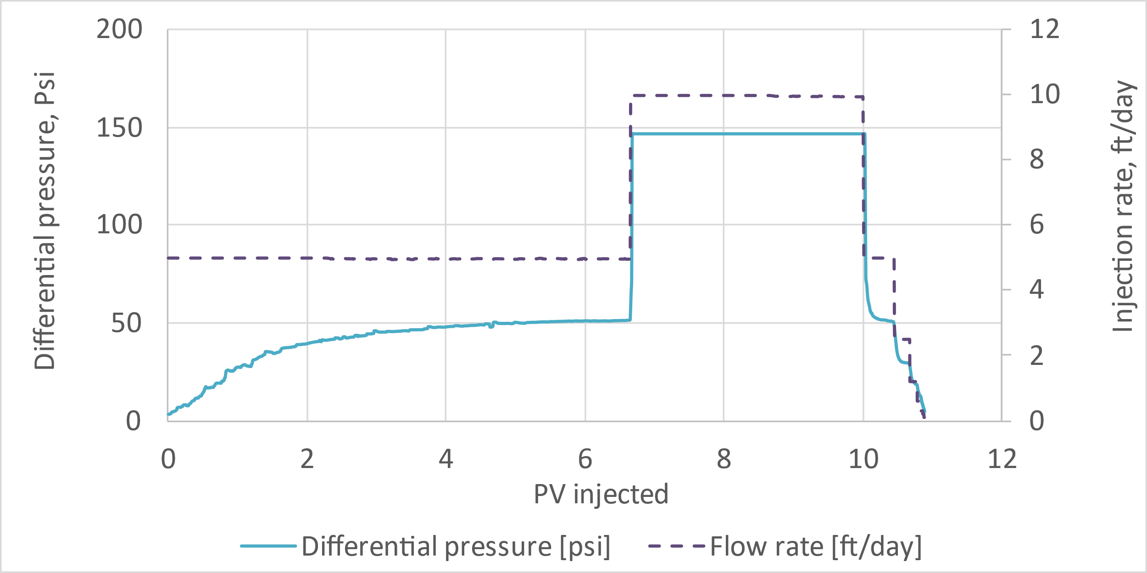
Results: ATBS-55 core flood, pressure profile, fresh vs aged polymer
ATBS-55 Fresh polymer
Injection polymer concentration: 2700 ppm
Injection viscosity (25 C, 7.3 1/S): 35 cP
Initial permeability: 122 mDa
Core: Berea Temperature: 100 C
ATBS-55 Aged polymer
Injection polymer concentration: 3000 ppm
Injection viscosity (25 C, 7.3 1/S): 33 cP
Initial permeability: 73 mDa
Core: Berea Temperature: 100 C

Slide 16
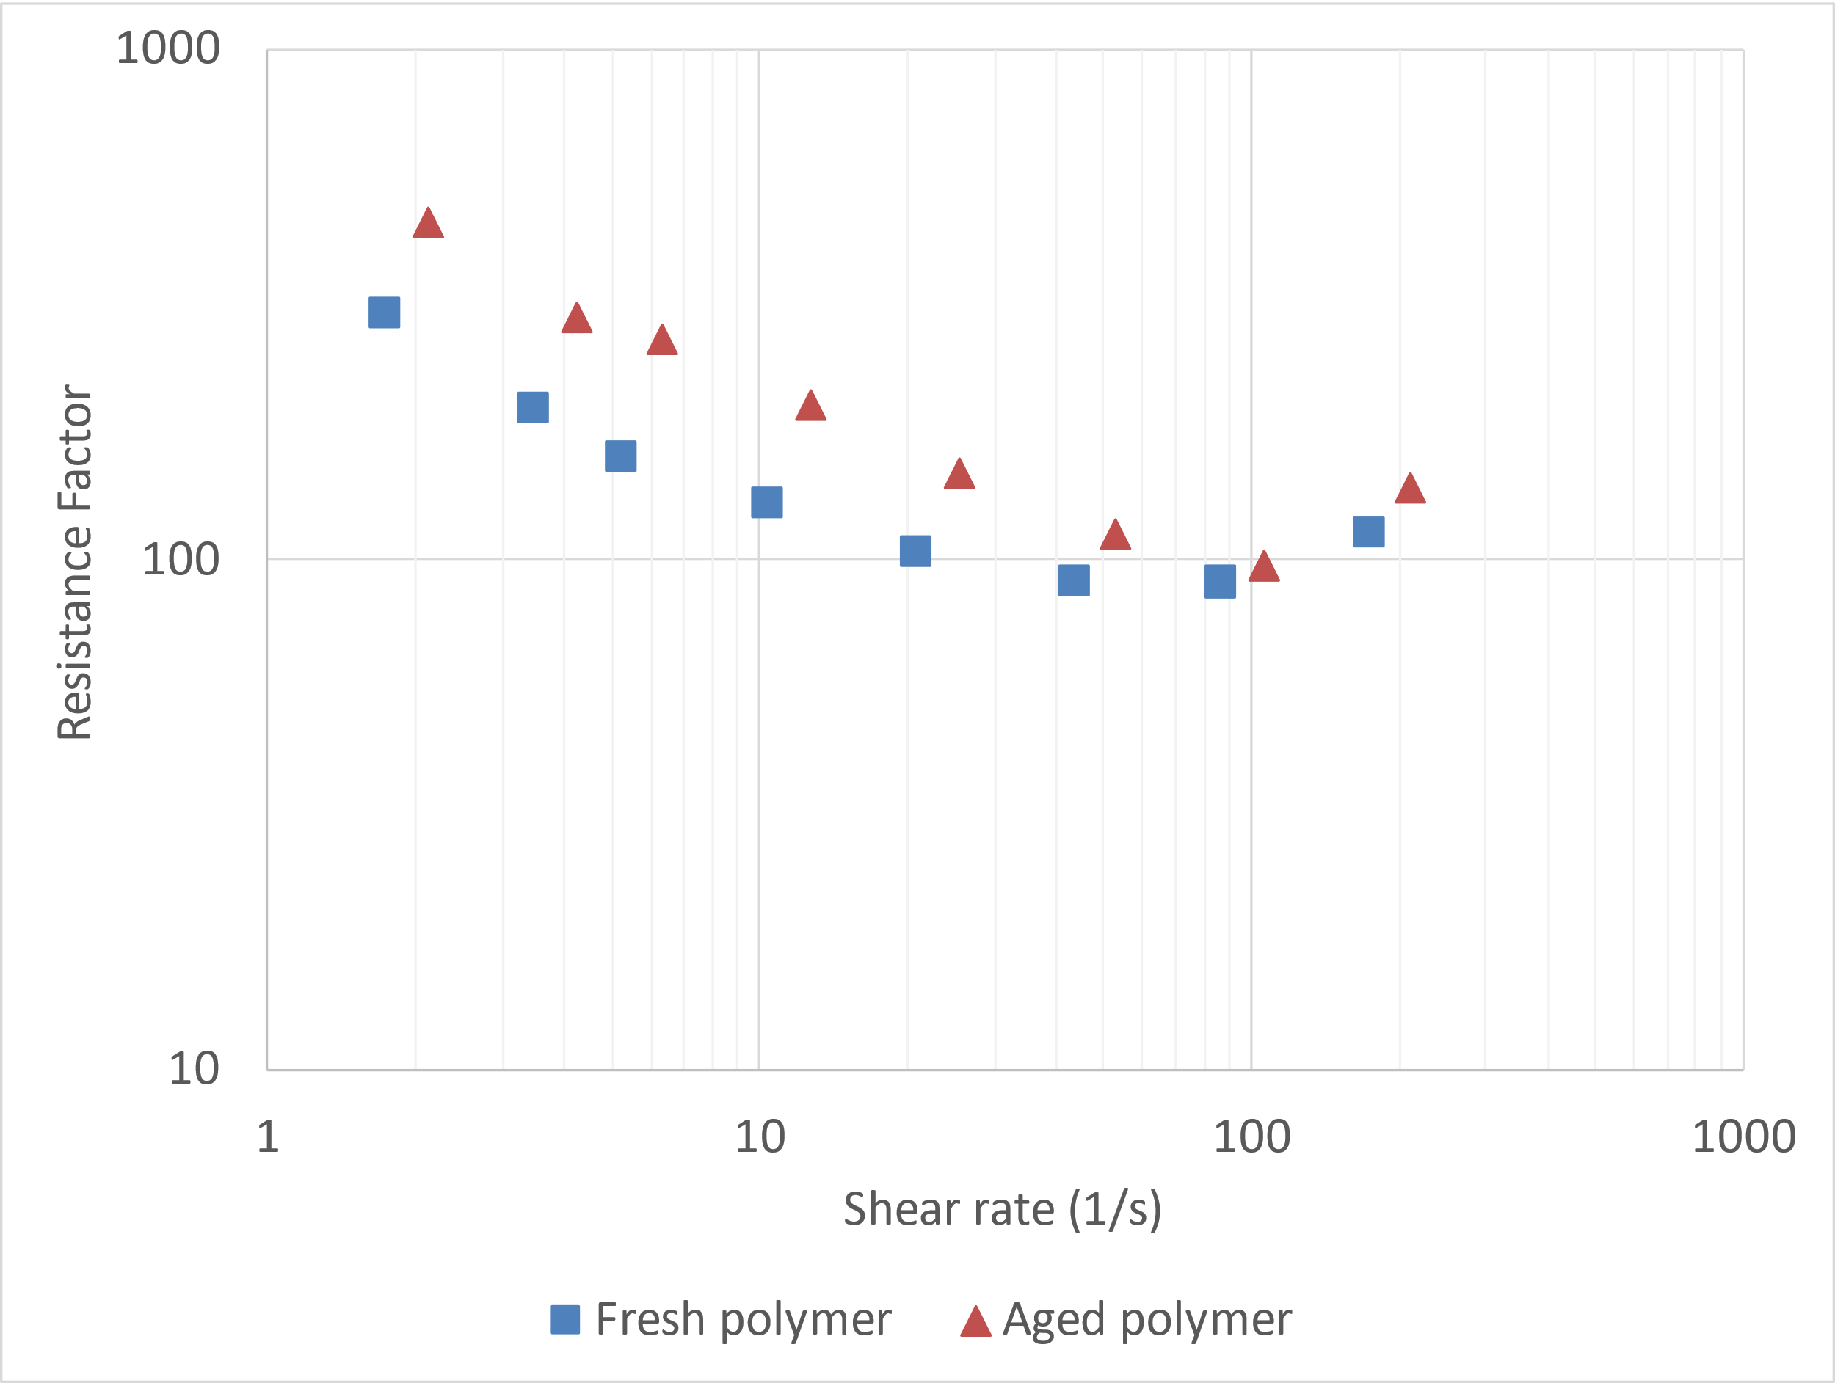
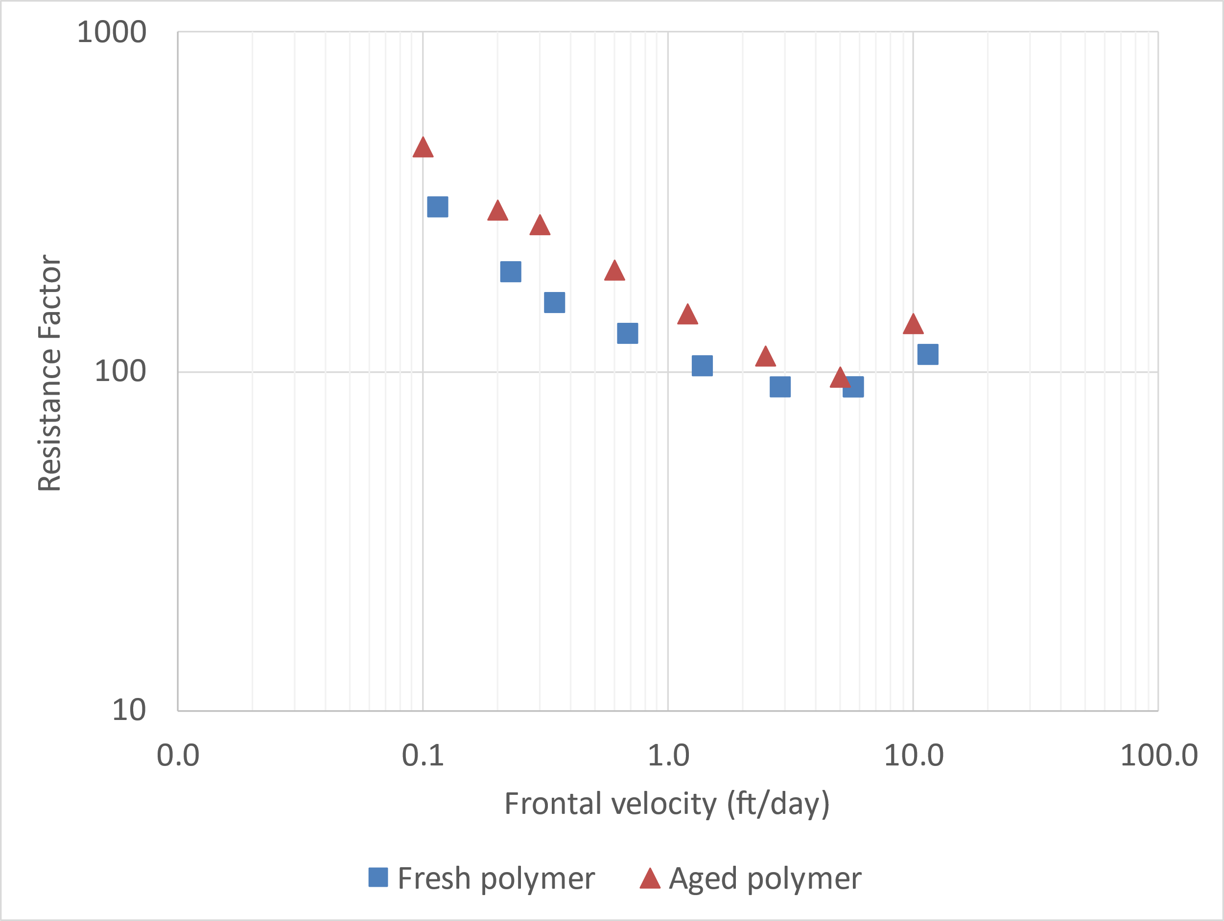
Results: ATBS-55 core flood, Resistance factor (RF), fresh vs aged polymer
Similar trend of Resistance factor for aged and fresh polymer

Slide 17
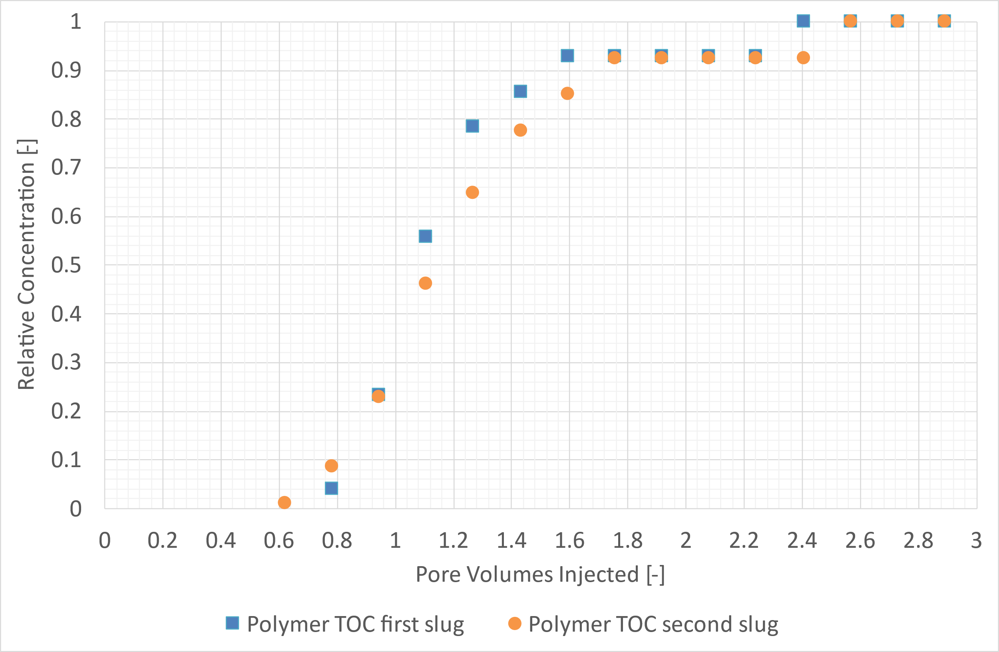
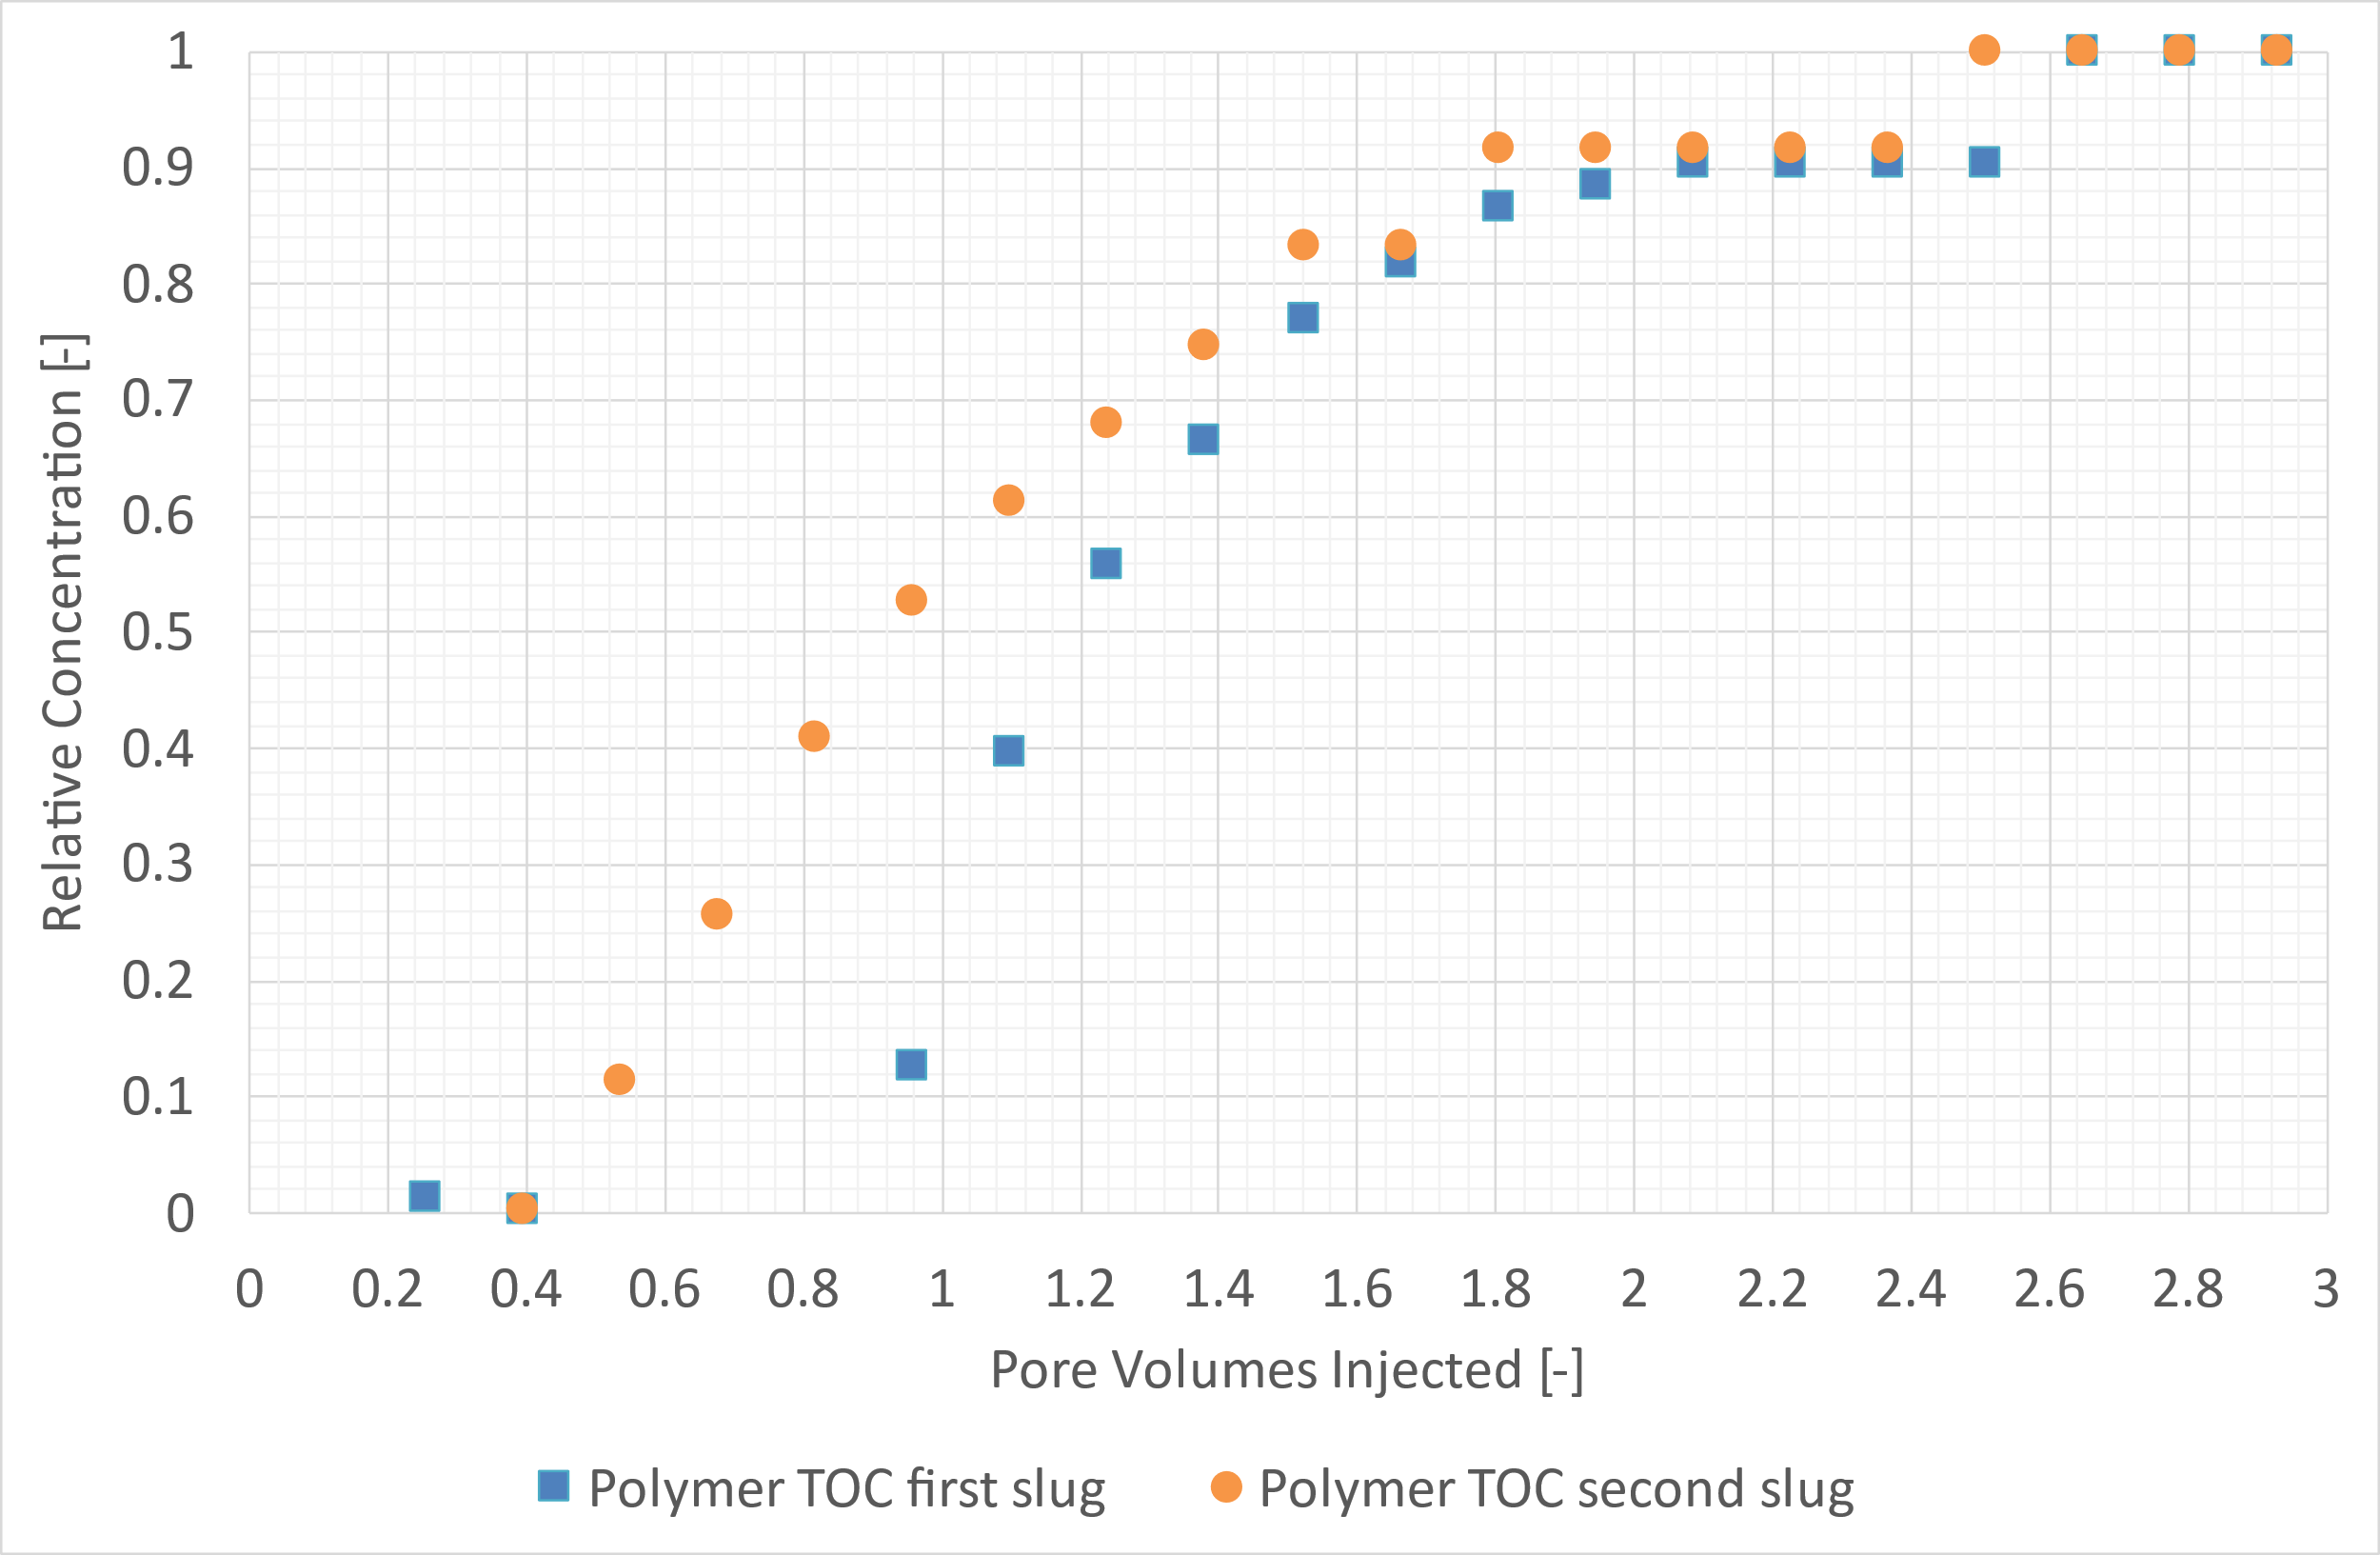
Results: ATBS-55 core flood, fresh vs aged polymer
Higher adsorption is seen for aged polymer
Fresh polymer
Aged polymer
Polymer | Initial permeability, mDa | Injection concentration, ppm | Injection viscosity, cP 7.3 1/s and 25 C | Adsorption, µg/g
ATBS-55 fresh | 122 | 2700 | 35 | Negligible
ATBS-55 aged | 73 | 3000 | 33 | 34.3

Slide 18
Take away message
The results of the study clearly demonstrate the increased stability of polymers with high sulfonated content over extended periods, making them preferable for applications requiring long-term stability.
The phenomenon of accelerated thermal aging was shown applicable for high ATBS content polymer, namely ATBS-90 and ATBS-100, for the timeframe considered
Both the fresh and aged samples exhibited stable pressure levels during injectivity test, indicating that injectivity and propagation remain favorable for both polymers.
A noticeable higher adsorption is observed for aged polymer. Changes in polymer properties and adsorption through reservoir should be considered in field development.

